Slide 2
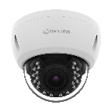
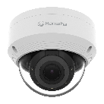
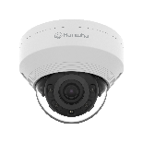
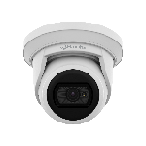
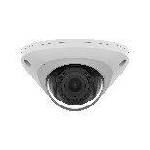
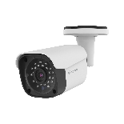
ø120.6mm(4.75") / 3 holes
ø120.6mm(4.75") / 3 holes
ø106mm(4.17") / 2 holes
ø109mm(4.29") / 2 holes
85.0mm(3.35") / 2 holes
ACV-8081R | ACV-8080R
ANV-L7082R | ANV-L6082R
ANV-L7012R | ANV-L6012R
ACE-8020R | ACE-6020R | ANE-L7012L
ANE-L7012R | ANE-L6012R
ANV-L6023R
ø59.0mm(2.32") / 3 holes
ACO-8020R | ACO-6020R | ANO-L7082R
ANO-L6082R | ANO-L7022R | ANO-L7012R
ANO-L6022R | ANO-L6012R

Slide 3
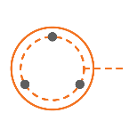
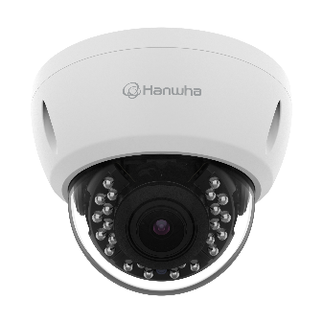
Compatible Camera List
Compatible Installation Solution List
Ceiling 1
Ceiling 2
Wall 1
Wall 2
Wall 3
Pole 1
Pole 2
Corner 1
Corner 2
Parapet
Dimension for Installation
ø120.6mm(4.75") / 3 holes
ACV-8081R
ø132.0x103.0mm(ø5.20"x4.06")
550g(1.21 lb)
ACV-8080R
ø132.0x103.0mm(ø5.20"x4.06")
550g(1.21 lb)

Slide 4
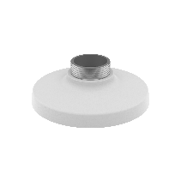
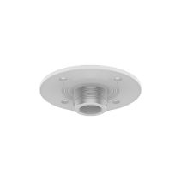
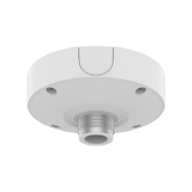
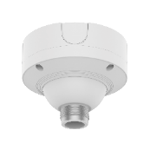
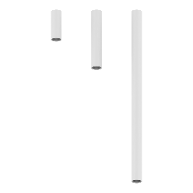
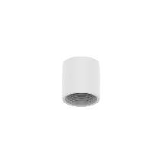
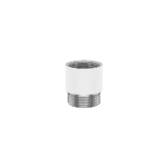
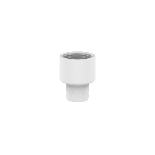
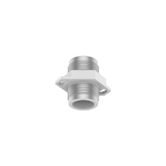
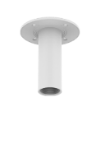
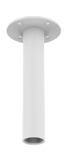
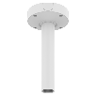
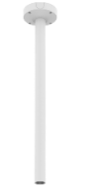
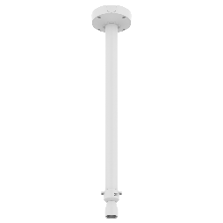
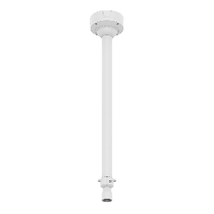
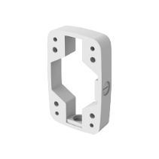
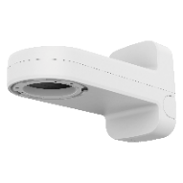
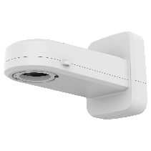
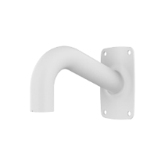
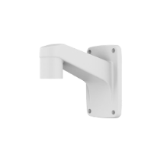
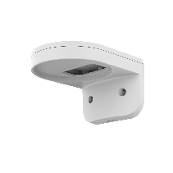
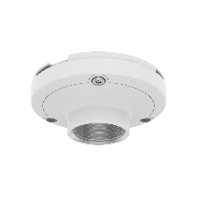
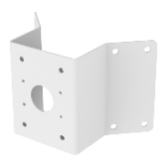
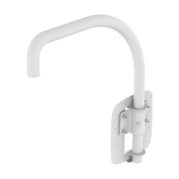
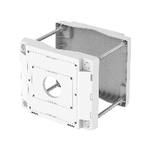
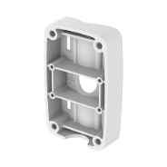
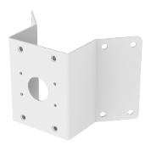
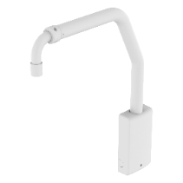
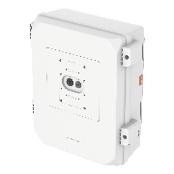
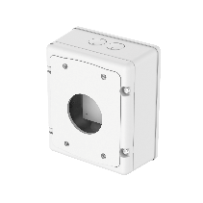
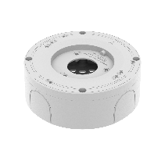
Compatible Camera List
Compatible Installation Solution List
Ceiling 1
Ceiling 2
Wall 1
Wall 2
Wall 3
Pole 1
Pole 2
Corner 1
Corner 2
Parapet
ACV - 8081R / 8080R
NEW
NEW
NEW
Hanging Adaptor
SBP-301HMW2
Ceiling Mount Base
SBP-140CMB
Ceiling Mount Base
SBP-180CMB
Ball Head
Ceiling Thread Converter
SBP-C15H
Ceiling Thread Converter
SBP-C15NP
Ceiling Pipe Converter
SBP-C35H
Ceiling Mount Base
SBP-180CMS
Ceiling Mount Pipe
SBP-150CMP/300CMP/900CMP
Ceiling Mount Coupler
SBP-C15P
Ceiling Mount (Assembly)
SBP-150CMI / 300CMI
Ceiling Mount (Assembly)
SBP-300CMW1 / 900CMW
Ceiling Mount (Telescopic)
SBP-300CMTW
Ball Head
Ceiling Mount (Telescopic)
SBP-300CMTS
Wall Mount Base
SBP-300BW1
Wall & Pole Mount
SBP-250WMW
Wall & Pole Mount
SBP-400WMW
Wall Mount
SBP-300WMW
Wall Mount
SBP-300WMW1
NEW
NEW
Wall Mount
SBP-137WMW1
Wall & Pole Adaptor
SBP-115PFA
Pole Mount
SBP-150PMW
Pole Mount
SBP-300PMW2
Corner Mount
SBP-300KMW1
Corner Mount
SBP-156KMW
Parapet Mount
SBP-300LMW
Parapet Mount (Telescopic)
SBP-156LMW1
Cabinet
SBP-150NBW
Cabinet
SBP-300NBW
Back Box
SBV-A14B

Slide 5
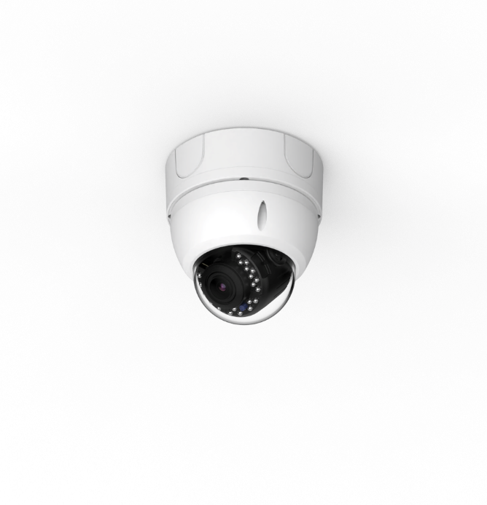
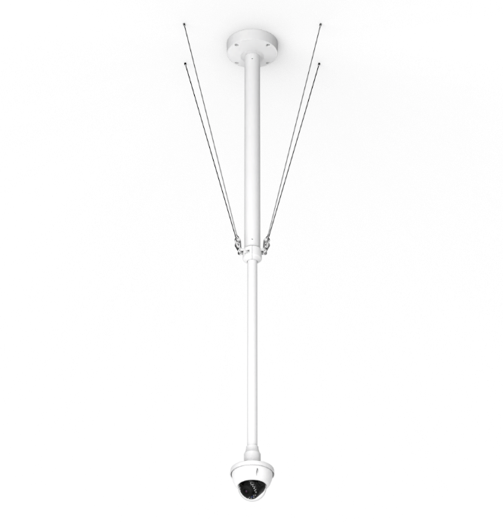
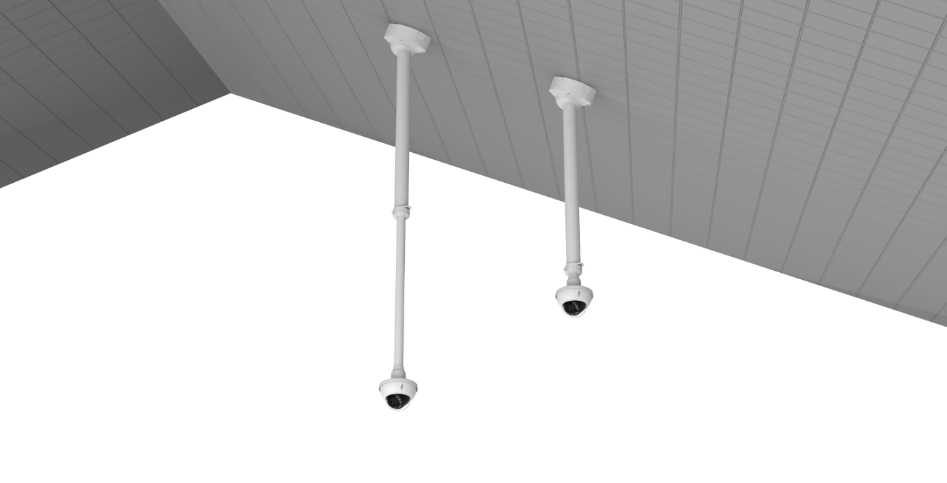
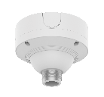
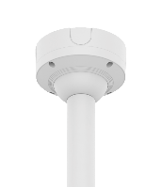
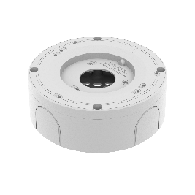
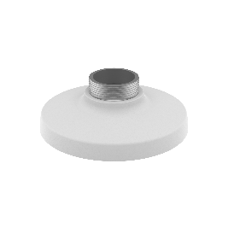
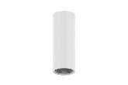
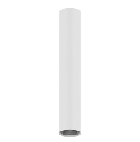
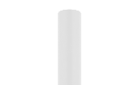
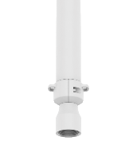

Compatible Camera List
Compatible Installation Solution List
Ceiling 1
Ceiling 2
Wall 1
Wall 2
Wall 3
Pole 1
Pole 2
Corner 1
Corner 2
Parapet
ACV - 8081R / 8080R
Back Box
Ceiling Mount
Hanging Adaptor
Ceiling Mount (Ball Head)
Hanging Adaptor
SBP-180CMS
SBP-180CMS
SBP-180CMS
or
or
or
SBP-150CMP
SBV-A14B
SBP-300CMTW
SBP-301HMW2
SBP-300CMP
SBP-301HMW2
SBP-900CMP
SBP-300CMTS

Slide 6











Compatible Camera List
Compatible Installation Solution List
Ceiling 1
Ceiling 2
Wall 1
Wall 2
Wall 3
Pole 1
Pole 2
Corner 1
Corner 2
Parapet
ACV - 8081R / 8080R
Ceiling Mount
Hanging Adaptor
Thread Converter
Ceiling Mount
Hanging Adaptor
Assembly
SBP-300CMW1
Assembly
SBP-900CMW
Option
Assembly
SBP-150CMI
Assembly
SBP-300CMI
SBP-180CMB
SBP-180CMB
SBP-180CMB
Coupler
SBP-C15P
SBP-140CMB
SBP-140CMB
SBP-140CMB
SBP-140CMB
or
or
+
SBP-C15H
or
or
or
SBP-150CMP
SBP-150CMP
SBP-300CMP
SBP-301HMW2
SBP-300CMP
SBP-301HMW2
SBP-900CMP
Ceiling Mount Pipe
SBP-900CMP

Slide 7




Compatible Camera List
Compatible Installation Solution List
Ceiling 1
Ceiling 2
Wall 1
Wall 2
Wall 3
Pole 1
Pole 2
Corner 1
Corner 2
Parapet
ACV - 8081R / 8080R
Cabinet
Back Box
Cabinet
Wall Mount
Option
Option
Cabinet
SBP-150NBW
Cabinet
SBP-150NBW
SBV-A14B
SBP-137WMW1

Slide 8






Compatible Camera List
Compatible Installation Solution List
Ceiling 1
Ceiling 2
Wall 1
Wall 2
Wall 3
Pole 1
Pole 2
Corner 1
Corner 2
Parapet
ACV - 8081R / 8080R
Cabinet
Wall & Pole Mount
Wall & Pole Adaptor
Hanging Adaptor
Option
or
Cabinet
SBP-150NBW
SBP-250WMW
SBP-400WMW
SBP-115PFA
SBP-301HMW2

Slide 9






Compatible Camera List
Compatible Installation Solution List
Ceiling 1
Ceiling 2
Wall 1
Wall 2
Wall 3
Pole 1
Pole 2
Corner 1
Corner 2
Parapet
ACV - 8081R / 8080R
Cabinet & Wall Mount
Hanging Adaptor
Option
or
or
Cabinet
SBP-300NBW
Wall Mount Base
SBP-300BW1
SBP-300WMW
SBP-300WMW1
SBP-301HMW2

Slide 10




Compatible Camera List
Compatible Installation Solution List
Ceiling 1
Ceiling 2
Wall 1
Wall 2
Wall 3
Pole 1
Pole 2
Corner 1
Corner 2
Parapet
ACV - 8081R / 8080R
Pole Mount & Cabinet
Wall & Pole Mount
Wall & Pole Adaptor
Hanging Adaptor
Option
or
Pole Mount
SBP-150PMW
Cabinet
SBP-150NBW
SBP-250WMW
SBP-400WMW
SBP-115PFA
SBP-301HMW2

Slide 11



Compatible Camera List
Compatible Installation Solution List
Ceiling 1
Ceiling 2
Wall 1
Wall 2
Wall 3
Pole 1
Pole 2
Corner 1
Corner 2
Parapet
ACV - 8081R / 8080R
Cabinet & Pole Mount
Wall Mount
Hanging Adaptor
Option
or
or
Cabinet
SBP-300NBW
Pole Mount Base
SBP-300PMW2
SBP-300WMW
SBP-300WMW1
SBP-301HMW2

Slide 12



Compatible Camera List
Compatible Installation Solution List
Ceiling 1
Ceiling 2
Wall 1
Wall 2
Wall 3
Pole 1
Pole 2
Corner 1
Corner 2
Parapet
ACV - 8081R / 8080R
Corner Mount
Wall & Pole Mount
Wall & Pole Adaptor
Hanging Adaptor
or
SBP-156KMW
SBP-250WMW
SBP-400WMW
SBP-115PFA
SBP-301HMW2

Slide 13




Compatible Camera List
Compatible Installation Solution List
Ceiling 1
Ceiling 2
Wall 1
Wall 2
Wall 3
Pole 1
Pole 2
Corner 1
Corner 2
Parapet
ACV - 8081R / 8080R
Corner Mount
Wall Mount
Corner Mount
Cabinet
Wall Mount
Hanging Adaptor
Option
or
SBP-300KMW1
SBP-137WMW1
SBP-300KMW1
Cabinet
SBP-300NBW
SBP-300WMW
SBP-300WMW1
SBP-301HMW2

Slide 14




Compatible Camera List
Compatible Installation Solution List
Ceiling 1
Ceiling 2
Wall 1
Wall 2
Wall 3
Pole 1
Pole 2
Corner 1
Corner 2
Parapet
ACV - 8081R / 8080R
Parapet Mount
Hanging Adaptor
Parapet Mount
Hanging Adaptor
SBP-300LMW
SBP-301HMW2
SBP-156LMW1
SBP-301HMW2

Slide 15

Compatible Camera List
Compatible Installation Solution List
Ceiling 1
Ceiling 2
Ceiling 3
Wall 1
Wall 2
Wall 3
Pole 1
Pole 2
Corner 1
Corner 2
Corner 3
Parapet
Dimension for Installation
ø120.6mm(4.75") / 3 holes or Mount Plate
ANV-L7082R
ø137.8x106.1mm(ø5.43"x4.18")
550g(1.21 lb)
ANV-L6082R
ø137.8x106.1mm(ø5.43"x4.18")
550g(1.21 lb)

Slide 16








Compatible Camera List
Compatible Installation Solution List
Ceiling 1
Ceiling 2
Ceiling 3
Wall 1
Wall 2
Wall 3
Pole 1
Pole 2
Corner 1
Corner 2
Corner 3
Parapet
ANV-L7082R / L6082R
NEW
NEW
NEW
Hanging Adaptor
SBP-301HMW2
Ceiling Mount Base
SBP-140CMB
Ceiling Mount Base
SBP-180CMB
Ball Head
Ceiling Thread Converter
SBP-C15H
Ceiling Thread Converter
SBP-C15NP
Ceiling Pipe Converter
SBP-C35H
Ceiling Mount Base
SBP-180CMS
Ceiling Mount Pipe
SBP-150CMP/300CMP/900CMP
Ceiling Mount Coupler
SBP-C15P
Ball Head
※ Mount plate needed
Plenum
Ceiling Mount (Assembly)
SBP-150CMI / 300CMI
Ceiling Mount (Assembly)
SBP-300CMW1 / 900CMW
Ceiling Mount (Telescopic)
SBP-300CMTW
Ceiling Mount (Telescopic)
SBP-300CMTS
Ceiling Mount (Tile Grid)
SBP-140CMT
In-Ceiling Housing
SHD-1408FPW
Wall & Pole Mount
SBP-250WMW
Wall &Pole Mount
SBP-400WMW
Wall Mount Base
SBP-300BW1
NEW
※ Mount plate needed
※ Mount plate needed
※ Mount plate needed
Wall Mount
SBP-300WMW
Wall Mount
SBP-300WMW1
Wall & Pole Adaptor
SBP-115PFA
Wall Mount
SBP-137WMW1
Pole Mount
SBP-150PMW
Pole Mount
SBD-140PMW
Pole Mount (Lite)
SBD-140PMB
Pole Mount
SBP-300PMW2
Corner Mount (Lite)
SBD-140KMB
NEW
Corner Mount
SBP-300KMW1
Corner Mount
SBP-156KMW
Parapet Mount
SBP-300LMW
Parapet Mount (Telescopic)
SBP-156LMW1
Cabinet
SBP-150NBW
Cabinet
SBP-300NBW
Back Box
SBV-A14B
Smoked Dome Cover
SPB-VAW72

Slide 17





Compatible Camera List
Compatible Installation Solution List
Ceiling 1
Ceiling 2
Ceiling 3
Wall 1
Wall 2
Wall 3
Pole 1
Pole 2
Corner 1
Corner 2
Corner 3
Parapet
ANV-L7082R / L6082R
Ceiling Mount(Tile Grid)
In-ceiling Mount
Back Box
※ Mount plate needed
Plenum
Plenum
SBP-140CMT
SHD-1408FPW
SBV-A14B

Slide 18


Compatible Camera List
Compatible Installation Solution List
Ceiling 1
Ceiling 2
Ceiling 3
Wall 1
Wall 2
Wall 3
Pole 1
Pole 2
Corner 1
Corner 2
Corner 3
Parapet
ANV-L7082R / L6082R
Ceiling Mount
Hanging Adaptor
Ceiling Mount (Ball Head)
Hanging Adaptor
SBP-180CMS
SBP-180CMS
SBP-180CMS
or
or
or
SBP-150CMP
SBP-300CMTW
SBP-301HMW2
SBP-300CMP
SBP-301HMW2
SBP-900CMP
SBP-300CMTS

Slide 19






Compatible Camera List
Compatible Installation Solution List
Ceiling 1
Ceiling 2
Ceiling 3
Wall 1
Wall 2
Wall 3
Pole 1
Pole 2
Corner 1
Corner 2
Corner 3
Parapet
ANV-L7082R / L6082R
Ceiling Mount
Hanging Adaptor
Thread Converter
Ceiling Mount
Hanging Adaptor
Assembly
SBP-300CMW1
Assembly
SBP-900CMW
Option
Assembly
SBP-150CMI
Assembly
SBP-300CMI
SBP-180CMB
SBP-180CMB
SBP-180CMB
Coupler
SBP-C15P
SBP-140CMB
SBP-140CMB
SBP-140CMB
SBP-140CMB
or
or
+
SBP-C15H
or
or
or
SBP-150CMP
SBP-150CMP
SBP-300CMP
SBP-301HMW2
SBP-300CMP
SBP-301HMW2
SBP-900CMP
Ceiling Mount Pipe
SBP-900CMP

Slide 20


Compatible Camera List
Compatible Installation Solution List
Ceiling 1
Ceiling 2
Ceiling 3
Wall 1
Wall 2
Wall 3
Pole 1
Pole 2
Corner 1
Corner 2
Corner 3
Parapet
ANV-L7082R / L6082R
Cabinet
Back Box
Cabinet
Wall Mount
Option
Option
Cabinet
SBP-150NBW
Cabinet
SBP-150NBW
SBV-A14B
SBP-137WMW1

Slide 21



Compatible Camera List
Compatible Installation Solution List
Ceiling 1
Ceiling 2
Ceiling 3
Wall 1
Wall 2
Wall 3
Pole 1
Pole 2
Corner 1
Corner 2
Corner 3
Parapet
ANV-L7082R / L6082R
Cabinet
Wall & Pole Mount
Wall & Pole Adaptor
Hanging Adaptor
Option
or
Cabinet
SBP-150NBW
SBP-250WMW
SBP-400WMW
SBP-115PFA
SBP-301HMW2

Slide 22


Compatible Camera List
Compatible Installation Solution List
Ceiling 1
Ceiling 2
Ceiling 3
Wall 1
Wall 2
Wall 3
Pole 1
Pole 2
Corner 1
Corner 2
Corner 3
Parapet
ANV-L7082R / L6082R
Cabinet & Wall Mount
Hanging Adaptor
Option
or
or
Cabinet
SBP-300NBW
Wall Mount Base
SBP-300BW1
SBP-300WMW
SBP-300WMW1
SBP-301HMW2

Slide 23



Compatible Camera List
Compatible Installation Solution List
Ceiling 1
Ceiling 2
Ceiling 3
Wall 1
Wall 2
Wall 3
Pole 1
Pole 2
Corner 1
Corner 2
Corner 3
Parapet
ANV-L7082R / L6082R
Pole Mount & Cabinet
Wall & Pole Mount
Wall & Pole Adaptor
Hanging Adaptor
Option
or
Pole Mount
SBP-150PMW
Cabinet
SBP-150NBW
SBP-250WMW
SBP-400WMW
SBP-115PFA
SBP-301HMW2

Slide 24






Compatible Camera List
Compatible Installation Solution List
Ceiling 1
Ceiling 2
Ceiling 3
Wall 1
Wall 2
Wall 3
Pole 1
Pole 2
Corner 1
Corner 2
Corner 3
Parapet
ANV-L7082R / L6082R
Pole Mount (Light)
Pole Mount
Cabinet & Pole Mount
Wall Mount
Hanging Adaptor
Option
or
or
※ Mount plate needed
※ Mount plate needed
SBD-140PMB
SBD-140PMW
Cabinet
SBP-300NBW
Pole Mount Base
SBP-300PMW2
SBP-300WMW
SBP-300WMW1
SBP-301HMW2

Slide 25




Compatible Camera List
Compatible Installation Solution List
Ceiling 1
Ceiling 2
Ceiling 3
Wall 1
Wall 2
Wall 3
Pole 1
Pole 2
Corner 1
Corner 2
Corner 3
Parapet
ANV-L7082R / L6082R
Corner Mount (Lite)
Corner Mount
Corner Mount
Wall Mount
or
※ Mount plate needed
SBD-140KMB
SBP-300KMW1
SBP-300KMW1
SBP-137WMW1

Slide 26


Compatible Camera List
Compatible Installation Solution List
Ceiling 1
Ceiling 2
Ceiling 3
Wall 1
Wall 2
Wall 3
Pole 1
Pole 2
Corner 1
Corner 2
Corner 3
Parapet
ANV-L7082R / L6082R
Corner Mount
Wall & Pole Mount
Wall & Pole Adaptor
Hanging Adaptor
or
SBP-156KMW
SBP-250WMW
SBP-400WMW
SBP-115PFA
SBP-301HMW2

Slide 27


Compatible Camera List
Compatible Installation Solution List
Ceiling 1
Ceiling 2
Ceiling 3
Wall 1
Wall 2
Wall 3
Pole 1
Pole 2
Corner 1
Corner 2
Corner 3
Parapet
ANV-L7082R / L6082R
Corner Mount
Cabinet
Wall Mount
Hanging Adaptor
Option
or
SBP-300KMW1
Cabinet
SBP-300NBW
SBP-300WMW
SBP-300WMW1
SBP-301HMW2

Slide 28


Compatible Camera List
Compatible Installation Solution List
Ceiling 1
Ceiling 2
Ceiling 3
Wall 1
Wall 2
Wall 3
Pole 1
Pole 2
Corner 1
Corner 2
Corner 3
Parapet
ANV-L7082R / L6082R
Parapet Mount
Hanging Adaptor
Parapet Mount
Hanging Adaptor
SBP-300LMW
SBP-301HMW2
SBP-156LMW1
SBP-301HMW2

Slide 29


Compatible Camera List
Compatible Installation Solution List
Ceiling 1
Ceiling 2
Ceiling 3
Wall 1
Wall 2
Wall 3
Pole 1
Pole 2
Corner 1
Corner 2
Corner 3
Parapet
Dimension for Installation
ø106.0mm(4.17") / 2 holes
ANV-L7012R
ø120.3x91.7mm(ø4.74"x3.61")
410g(0.90 lb)
ANV-L6012R
ø120.3x91.7mm(ø4.74"x3.61")
410g(0.90 lb)

Slide 30


Compatible Camera List
Compatible Installation Solution List
Ceiling 1
Ceiling 2
Ceiling 3
Wall 1
Wall 2
Wall 3
Pole 1
Pole 2
Corner 1
Corner 2
Corner 3
Parapet
ANV - L7012R / L6012R
NEW
NEW
NEW
Hanging Adaptor
SBP-122HMW
Ceiling Mount Base
SBP-140CMB
Ceiling Mount Base
SBP-180CMB
Ball Head
Ceiling Thread Converter
SBP-C15H
Ceiling Thread Converter
SBP-C15NP
Ceiling Pipe Converter
SBP-C35H
Ceiling Mount Base
SBP-180CMS
Ceiling Mount Pipe
SBP-150CMP/300CMP/900CMP
Ceiling Mount Coupler
SBP-C15P
Ball Head
※ Mount plate needed
Plenum
Ceiling Mount (Assembly)
SBP-150CMI / 300CMI
Ceiling Mount (Assembly)
SBP-300CMW1 / 900CMW
Ceiling Mount (Telescopic)
SBP-300CMTW
Ceiling Mount (Telescopic)
SBP-300CMTS
Ceiling Mount (Tile Grid)
SBP-140CMT
In-Ceiling Housing
SHD-1408FPW
Wall & Pole Mount
SBP-250WMW
Wall &Pole Mount
SBP-400WMW
Wall Mount Base
SBP-300BW1
NEW
※ Mount plate needed
※ Mount plate needed
※ Mount plate needed
Wall Mount
SBP-300WMW
Wall Mount
SBP-300WMW1
Wall & Pole Adaptor
SBP-115PFA
Wall Mount
SBP-137WMW1
Pole Mount
SBP-150PMW
Pole Mount
SBD-140PMW
Pole Mount (Lite)
SBD-140PMB
Pole Mount
SBP-300PMW2
Corner Mount (Lite)
SBD-140KMB
NEW
Corner Mount
SBP-300KMW1
Corner Mount
SBP-156KMW
Parapet Mount
SBP-300LMW
Parapet Mount (Telescopic)
SBP-156LMW1
Cabinet
SBP-150NBW
Cabinet
SBP-300NBW
Back Box
SBV-A14B
Weather Cap
SBV-120WCW
Smoked Dome Cover
SPB-VAW72

Slide 31

Compatible Camera List
Compatible Installation Solution List
Ceiling 1
Ceiling 2
Ceiling 3
Wall 1
Wall 2
Wall 3
Pole 1
Pole 2
Corner 1
Corner 2
Corner 3
Parapet
ANV - L7012R / L6012R
Ceiling Mount(Tile Grid)
In-ceiling Mount
Back Box
※ Mount plate needed
Plenum
Plenum
SBP-140CMT
SHD-1408FPW
SBV-A14B

Slide 32



Compatible Camera List
Compatible Installation Solution List
Ceiling 1
Ceiling 2
Ceiling 3
Wall 1
Wall 2
Wall 3
Pole 1
Pole 2
Corner 1
Corner 2
Corner 3
Parapet
ANV - L7012R / L6012R
Ceiling Mount
Hanging Adaptor
Ceiling Mount (Ball Head)
Hanging Adaptor
SBP-180CMS
SBP-180CMS
SBP-180CMS
or
or
or
SBP-150CMP
SBP-300CMTW
SBP-122HMW
SBP-300CMP
SBP-122HMW
SBP-900CMP
SBP-300CMTS

Slide 33






Compatible Camera List
Compatible Installation Solution List
Ceiling 1
Ceiling 2
Ceiling 3
Wall 1
Wall 2
Wall 3
Pole 1
Pole 2
Corner 1
Corner 2
Corner 3
Parapet
ANV - L7012R / L6012R
Ceiling Mount
Hanging Adaptor
Thread Converter
Ceiling Mount
Hanging Adaptor
Assembly
SBP-300CMW1
Assembly
SBP-900CMW
Option
Assembly
SBP-150CMI
Assembly
SBP-300CMI
SBP-180CMB
SBP-180CMB
SBP-180CMB
Coupler
SBP-C15P
SBP-140CMB
SBP-140CMB
SBP-140CMB
SBP-140CMB
or
or
+
SBP-C15H
or
or
or
SBP-150CMP
SBP-150CMP
SBP-300CMP
SBP-122HMW
SBP-300CMP
SBP-122HMW
SBP-900CMP
Ceiling Mount Pipe
SBP-900CMP

Slide 34


Compatible Camera List
Compatible Installation Solution List
Ceiling 1
Ceiling 2
Ceiling 3
Wall 1
Wall 2
Wall 3
Pole 1
Pole 2
Corner 1
Corner 2
Corner 3
Parapet
ANV - L7012R / L6012R
Cabinet
Back Box
Cabinet
Wall Mount
Option
Option
Cabinet
SBP-150NBW
Cabinet
SBP-150NBW
SBV-A14B
SBP-137WMW1

Slide 35



Compatible Camera List
Compatible Installation Solution List
Ceiling 1
Ceiling 2
Ceiling 3
Wall 1
Wall 2
Wall 3
Pole 1
Pole 2
Corner 1
Corner 2
Corner 3
Parapet
ANV - L7012R / L6012R
Cabinet
Wall & Pole Mount
Wall & Pole Adaptor
Hanging Adaptor
Option
or
Cabinet
SBP-150NBW
SBP-250WMW
SBP-400WMW
SBP-115PFA
SBP-122HMW

Slide 36


Compatible Camera List
Compatible Installation Solution List
Ceiling 1
Ceiling 2
Ceiling 3
Wall 1
Wall 2
Wall 3
Pole 1
Pole 2
Corner 1
Corner 2
Corner 3
Parapet
ANV - L7012R / L6012R
Cabinet & Wall Mount
Hanging Adaptor
Option
or
or
Cabinet
SBP-300NBW
Wall Mount Base
SBP-300BW1
SBP-300WMW
SBP-300WMW1
SBP-122HMW

Slide 37



Compatible Camera List
Compatible Installation Solution List
Ceiling 1
Ceiling 2
Ceiling 3
Wall 1
Wall 2
Wall 3
Pole 1
Pole 2
Corner 1
Corner 2
Corner 3
Parapet
ANV - L7012R / L6012R
Pole Mount & Cabinet
Wall & Pole Mount
Wall & Pole Adaptor
Hanging Adaptor
Option
or
Pole Mount
SBP-150PMW
Cabinet
SBP-150NBW
SBP-250WMW
SBP-400WMW
SBP-115PFA
SBP-122HMW

Slide 38


Compatible Camera List
Compatible Installation Solution List
Ceiling 1
Ceiling 2
Ceiling 3
Wall 1
Wall 2
Wall 3
Pole 1
Pole 2
Corner 1
Corner 2
Corner 3
Parapet
ANV - L7012R / L6012R
Pole Mount (Light)
Pole Mount
Cabinet & Pole Mount
Wall Mount
Hanging Adaptor
Option
or
or
※ Mount plate needed
※ Mount plate needed
SBD-140PMB
SBD-140PMW
Cabinet
SBP-300NBW
Pole Mount Base
SBP-300PMW2
SBP-300WMW
SBP-300WMW1
SBP-122HMW

Slide 39


Compatible Camera List
Compatible Installation Solution List
Ceiling 1
Ceiling 2
Ceiling 3
Wall 1
Wall 2
Wall 3
Pole 1
Pole 2
Corner 1
Corner 2
Corner 3
Parapet
ANV - L7012R / L6012R
Corner Mount (Lite)
Corner Mount
Corner Mount
Wall Mount
or
※ Mount plate needed
SBD-140KMB
SBP-300KMW1
SBP-300KMW1
SBP-137WMW1

Slide 40


Compatible Camera List
Compatible Installation Solution List
Ceiling 1
Ceiling 2
Ceiling 3
Wall 1
Wall 2
Wall 3
Pole 1
Pole 2
Corner 1
Corner 2
Corner 3
Parapet
ANV - L7012R / L6012R
Corner Mount
Wall & Pole Mount
Wall & Pole Adaptor
Hanging Adaptor
or
SBP-156KMW
SBP-250WMW
SBP-400WMW
SBP-115PFA
SBP-122HMW

Slide 41


Compatible Camera List
Compatible Installation Solution List
Ceiling 1
Ceiling 2
Ceiling 3
Wall 1
Wall 2
Wall 3
Pole 1
Pole 2
Corner 1
Corner 2
Corner 3
Parapet
ANV - L7012R / L6012R
Corner Mount
Cabinet
Wall Mount
Hanging Adaptor
Option
or
SBP-300KMW1
Cabinet
SBP-300NBW
SBP-300WMW
SBP-300WMW1
SBP-122HMW

Slide 42


Compatible Camera List
Compatible Installation Solution List
Ceiling 1
Ceiling 2
Ceiling 3
Wall 1
Wall 2
Wall 3
Pole 1
Pole 2
Corner 1
Corner 2
Corner 3
Parapet
ANV - L7012R / L6012R
Parapet Mount
Hanging Adaptor
Parapet Mount
Hanging Adaptor
SBP-300LMW
SBP-122HMW
SBP-156LMW1
SBP-122HMW

Slide 43



Compatible Camera List
Compatible Installation Solution List
Ceiling 1
Ceiling 2
Ceiling 3
Wall 1
Wall 2
Wall 3
Pole 1
Pole 2
Pole 3
Corner 1
Corner 2
Corner 3
Parapet
Dimension for Installation
ø109.0mm(4.29") / 2 holes
ACE-8020R
ø120.0x82.0mm(4.72"x3.23")
410g(0.90 lb)
ACE-8020R
ø120.0x82.0mm(4.72"x3.23")
410g(0.90 lb)
ANE-L7012L
ø125.0x87.4mm(4.92"x3.44")
620g(1.36 lb)
ANE-L7012R
ø125.0x87.4mm(4.92"x3.44")
630g(1.39 lb)
ANE-L6012R
ø125.0x87.4mm(4.92"x3.44")
630g(1.39 lb)

Slide 44







Compatible Camera List
Compatible Installation Solution List
Ceiling 1
Ceiling 2
Ceiling 3
Wall 1
Wall 2
Wall 3
Pole 1
Pole 2
Pole 3
Corner 1
Corner 2
Corner 3
Parapet
ACE - 8020R / 6020R // ANE - L7012L / L7012R / L6012R
NEW
NEW
NEW
Hanging Adaptor
SBP-125HMW
Ceiling Mount Base
SBP-140CMB
Ceiling Mount Base
SBP-180CMB
Ball Head
Ceiling Thread Converter
SBP-C15H
Ceiling Thread Converter
SBP-C15NP
Ceiling Pipe Converter
SBP-C35H
Ceiling Mount Base
SBP-180CMS
Ceiling Mount Pipe
SBP-150CMP/300CMP/900CMP
Ceiling Mount Coupler
SBP-C15P
Ball Head
Ceiling Mount (Assembly)
SBP-150CMI / 300CMI
Ceiling Mount (Assembly)
SBP-300CMW1 / 900CMW
Ceiling Mount (Telescopic)
SBP-300CMTW
Ceiling Mount (Telescopic)
SBP-300CMTS
Wall & Pole Mount
SBP-250WMW
Wall &Pole Mount
SBP-400WMW
Wall Mount Base
SBP-300BW1
Wall Mount
SBP-300WMW
Wall Mount
SBP-300WMW1
NEW
Wall & Pole Mount
SBP-125WMW1
Wall & Pole Adaptor
SBP-115PFA
Tilt Mount
SBV-140TMW
Pole Mount
SBP-150PMW
Pole Mount
SBD-140PMW
Pole Mount (Lite)
SBD-140PMB
Pole Mount
SBP-300PMW2
Corner Mount (Lite)
SBD-140KMB
Corner Mount
SBP-300KMW1
NEW
Corner Mount
SBP-156KMW
Parapet Mount
SBP-300LMW
Parapet Mount (Telescopic)
SBP-156LMW1
Cabinet
SBP-150NBW
Cabinet
SBP-300NBW
Back Box
SBV-A14B
Gang Plate
SBD-110GP1

Slide 45




Compatible Camera List
Compatible Installation Solution List
Ceiling 1
Ceiling 2
Ceiling 3
Wall 1
Wall 2
Wall 3
Pole 1
Pole 2
Pole 3
Corner 1
Corner 2
Corner 3
Parapet
ACE - 8020R / 6020R // ANE - L7012L / L7012R / L6012R
Gang Box
Gang Plate
Back Box
Plenum
SBD-110GP1
SBV-A14B

Slide 46



Compatible Camera List
Compatible Installation Solution List
Ceiling 1
Ceiling 2
Ceiling 3
Wall 1
Wall 2
Wall 3
Pole 1
Pole 2
Pole 3
Corner 1
Corner 2
Corner 3
Parapet
ACE - 8020R / 6020R // ANE - L7012L / L7012R / L6012R
Ceiling Mount
Hanging Adaptor
Ceiling Mount (Ball Head)
Hanging Adaptor
SBP-180CMS
SBP-180CMS
SBP-180CMS
or
or
or
SBP-150CMP
SBP-300CMTW
SBP-125HMW
SBP-300CMP
SBP-125HMW
SBP-900CMP
SBP-300CMTS

Slide 47






Compatible Camera List
Compatible Installation Solution List
Ceiling 1
Ceiling 2
Ceiling 3
Wall 1
Wall 2
Wall 3
Pole 1
Pole 2
Pole 3
Corner 1
Corner 2
Corner 3
Parapet
ACE - 8020R / 6020R // ANE - L7012L / L7012R / L6012R
Ceiling Mount
Hanging Adaptor
Thread Converter
Ceiling Mount
Hanging Adaptor
Assembly
SBP-300CMW1
Assembly
SBP-900CMW
Option
Assembly
SBP-150CMI
Assembly
SBP-300CMI
SBP-180CMB
SBP-180CMB
SBP-180CMB
Coupler
SBP-C15P
SBP-140CMB
SBP-140CMB
SBP-140CMB
SBP-140CMB
or
or
+
SBP-C15H
or
or
or
SBP-150CMP
SBP-150CMP
SBP-300CMP
SBP-125HMW
SBP-300CMP
SBP-125HMW
SBP-900CMP
Ceiling Mount Pipe
SBP-900CMP

Slide 48






Compatible Camera List
Compatible Installation Solution List
Ceiling 1
Ceiling 2
Ceiling 3
Wall 1
Wall 2
Wall 3
Pole 1
Pole 2
Pole 3
Corner 1
Corner 2
Corner 3
Parapet
ACE - 8020R / 6020R // ANE - L7012L / L7012R / L6012R
Gang Box
Cabinet
Gang Plate
Back Box
Cabinet
Wall & Pole Mount
Cabinet
Tilt Mount
Option
Option
Option
or
Cabinet
SBP-150NBW
Cabinet
SBP-150NBW
Cabinet
SBP-150NBW
SBD-110GP1
SBV-A14B
SBP-125WMW1
SBV-140TMW

Slide 49



Compatible Camera List
Compatible Installation Solution List
Ceiling 1
Ceiling 2
Ceiling 3
Wall 1
Wall 2
Wall 3
Pole 1
Pole 2
Pole 3
Corner 1
Corner 2
Corner 3
Parapet
ACE - 8020R / 6020R // ANE - L7012L / L7012R / L6012R
Cabinet
Wall & Pole Mount
Wall & Pole Adaptor
Hanging Adaptor
Option
or
Cabinet
SBP-150NBW
SBP-250WMW
SBP-400WMW
SBP-115PFA
SBP-125HMW

Slide 50


Compatible Camera List
Compatible Installation Solution List
Ceiling 1
Ceiling 2
Ceiling 3
Wall 1
Wall 2
Wall 3
Pole 1
Pole 2
Pole 3
Corner 1
Corner 2
Corner 3
Parapet
ACE - 8020R / 6020R // ANE - L7012L / L7012R / L6012R
Cabinet & Wall Mount
Hanging Adaptor
Option
or
or
Cabinet
SBP-300NBW
Wall Mount Base
SBP-300BW1
SBP-300WMW
SBP-300WMW1
SBP-125HMW

Slide 51



Compatible Camera List
Compatible Installation Solution List
Ceiling 1
Ceiling 2
Ceiling 3
Wall 1
Wall 2
Wall 3
Pole 1
Pole 2
Pole 3
Corner 1
Corner 2
Corner 3
Parapet
ACE - 8020R / 6020R // ANE - L7012L / L7012R / L6012R
Pole Mount (Light)
Pole Mount
Pole Mount & Cabinet
Wall & Pole Mount
Option
Pole Mount
SBP-150PMW
Cabinet
SBP-150NBW
SBD-140PMB
SBD-140PMW
SBP-125WMW1

Slide 52



Compatible Camera List
Compatible Installation Solution List
Ceiling 1
Ceiling 2
Ceiling 3
Wall 1
Wall 2
Wall 3
Pole 1
Pole 2
Pole 3
Corner 1
Corner 2
Corner 3
Parapet
ACE - 8020R / 6020R // ANE - L7012L / L7012R / L6012R
Pole Mount & Cabinet
Wall & Pole Mount
Wall & Pole Adaptor
Hanging Adaptor
Option
or
Pole Mount
SBP-150PMW
Cabinet
SBP-150NBW
SBP-250WMW
SBP-400WMW
SBP-115PFA
SBP-125HMW

Slide 53


Compatible Camera List
Compatible Installation Solution List
Ceiling 1
Ceiling 2
Ceiling 3
Wall 1
Wall 2
Wall 3
Pole 1
Pole 2
Pole 3
Corner 1
Corner 2
Corner 3
Parapet
ACE - 8020R / 6020R // ANE - L7012L / L7012R / L6012R
Cabinet & Pole Mount
Wall Mount
Hanging Adaptor
Option
or
or
Cabinet
SBP-300NBW
Pole Mount Base
SBP-300PMW2
SBP-300WMW
SBP-300WMW1
SBP-125HMW

Slide 54


Compatible Camera List
Compatible Installation Solution List
Ceiling 1
Ceiling 2
Ceiling 3
Wall 1
Wall 2
Wall 3
Pole 1
Pole 2
Pole 3
Corner 1
Corner 2
Corner 3
Parapet
ACE - 8020R / 6020R // ANE - L7012L / L7012R / L6012R
Corner Mount (Lite)
Corner Mount
Corner Mount
Wall & Pole Mount
or
SBD-140KMB
SBP-300KMW1
SBP-300KMW1
SBP-125WMW1

Slide 55


Compatible Camera List
Compatible Installation Solution List
Ceiling 1
Ceiling 2
Ceiling 3
Wall 1
Wall 2
Wall 3
Pole 1
Pole 2
Pole 3
Corner 1
Corner 2
Corner 3
Parapet
ACE - 8020R / 6020R // ANE - L7012L / L7012R / L6012R
Corner Mount
Wall & Pole Mount
Wall & Pole Adaptor
Hanging Adaptor
or
SBP-156KMW
SBP-250WMW
SBP-400WMW
SBP-115PFA
SBP-125HMW

Slide 56


Compatible Camera List
Compatible Installation Solution List
Ceiling 1
Ceiling 2
Ceiling 3
Wall 1
Wall 2
Wall 3
Pole 1
Pole 2
Pole 3
Corner 1
Corner 2
Corner 3
Parapet
ACE - 8020R / 6020R // ANE - L7012L / L7012R / L6012R
Corner Mount
Cabinet
Wall Mount
Hanging Adaptor
Option
or
SBP-300KMW1
Cabinet
SBP-300NBW
SBP-300WMW
SBP-300WMW1
SBP-125HMW

Slide 57


Compatible Camera List
Compatible Installation Solution List
Ceiling 1
Ceiling 2
Ceiling 3
Wall 1
Wall 2
Wall 3
Pole 1
Pole 2
Pole 3
Corner 1
Corner 2
Corner 3
Parapet
ACE - 8020R / 6020R // ANE - L7012L / L7012R / L6012R
Parapet Mount
Hanging Adaptor
Parapet Mount
Hanging Adaptor
SBP-300LMW
SBP-125HMW
SBP-156LMW1
SBP-125HMW

Slide 58


Compatible Camera List
Dimension for Installation
85.0mm(3.35") / 2 holes
ANV-L6023R
98.9x52.0x100.0mm(3.89"x2.05 "x3.94")
295g(0.65 lb)

Slide 59



Compatible Camera List
Compatible Installation Solution List
Ceiling 1
Ceiling 2
Ceiling 3
Ceiling 4
Wall 1
Wall 2
Wall 3
Pole 1
Pole 2
Pole 3
Corner 1
Corner 2
Corner 3
Parapet
Dimension for Installation
ø59.0mm(2.32") / 3 holes
ACO-8020R
70.0(W)x69.0(H)x186.0(D)mm(2.76"x2.72"x7.32")
420g(0.93 lb)
ACO-6020R
70.0(W)x69.0(H)x186.0(D)mm(2.76"x2.72"x7.32")
420g(0.93 lb)
ANO-L7082R
ø78.0x262.0mm(3.07"x10.31")
390g(0.86 lb)
ANO-L7022R
ø78.0x262.0mm(3.07"x10.31")
390g(0.86 lb)
ANO-L7012R
ø78.0x262.0mm(3.07"x10.31")
390g(0.86 lb)
ANO-L6082R
ø78.0x262.0mm(3.07"x10.31")
390g(0.86 lb)
ANO-L6022R
ø78.0x262.0mm(3.07"x10.31")
390g(0.86 lb)
ANO-L6012R
ø78.0x262.0mm(3.07"x10.31")
390g(0.86 lb)

Slide 60





Compatible Camera List
Compatible Installation Solution List
Ceiling 1
Ceiling 2
Ceiling 3
Ceiling 4
Wall 1
Wall 2
Wall 3
Pole 1
Pole 2
Pole 3
Corner 1
Corner 2
Corner 3
Parapet
ACO - 8020R / 6020R // ANO - L7082R / L7022R / L7012R / L6082R / L6022R / L6012R
※ Essential Model for additional compatibility ※
NEW
Hanging Adaptor
SBP-140HMW
Ceiling Mount Base
SBP-140CMB
Ceiling Mount Base
SBP-180CMB
Ball Head
Ceiling Thread Converter
SBP-C15H
Gang Plate
SBO-090GP
Back Box
SBO-140BW
Ceiling Mount Base
SBP-180CMS
Ceiling Mount Pipe
SBP-150CMP/300CMP/900CMP
NEW
NEW
Ceiling Thread Converter
SBP-C15NP
Ceiling Pipe Converter
SBP-C35H
Ceiling Mount Coupler
SBP-C15P
Ceiling Mount (Assembly)
SBP-150CMI / 300CMI
Ceiling Mount (Assembly)
SBP-300CMW1 / 900CMW
Ceiling Mount (Telescopic)
SBP-300CMTW
Ball Head
Ceiling Mount (Telescopic)
SBP-300CMTS
Wall Mount Base
SBP-300BW
Wall & Pole Mount
SBP-250WMW
NEW
Wall & Pole Mount
SBP-400WMW
Wall Mount
SBP-300WMW
Wall Mount
SBP-300WMW1
Wall & Pole Mount
SBP-140WMW
Wall & Pole Adaptor
SBP-115PFA
Tilt Mount
SBV-140TMW
Pole Mount
SBP-150PMW
Pole Mount
SBD-140PMW
Pole Mount (Lite)
SBD-140PMB
NEW
Pole Mount
SBP-300PMW2
Corner Mount (Lite)
SBD-140KMB
Corner Mount
SBP-300KMW1
Corner Mount
SBP-156KMW
Parapet Mount (Telescopic)
SBP-156LMW1
Parapet Mount
SBP-300LMW
Cabinet
SBP-150NBW
Cabinet
SBP-300NBW

Slide 61






Compatible Camera List
Compatible Installation Solution List
Ceiling 1
Ceiling 2
Ceiling 3
Ceiling 4
Wall 1
Wall 2
Wall 3
Pole 1
Pole 2
Pole 3
Corner 1
Corner 2
Corner 3
Parapet
ACO - 8020R / 6020R // ANO - L7082R / L7022R / L7012R / L6082R / L6022R / L6012R
Gang Box
Gang Plate
Back Box
Ceiling Mount
Hanging Adaptor
Gang Plate & Back Box
Essential
or
or
Gang Plate
SBO-090GP
Back Box
SBO-140BW
SBO-090GP
SBV-A14B
SBP-300CMTW
SBP-140WMW

Slide 62

Compatible Camera List
Compatible Installation Solution List
Ceiling 1
Ceiling 2
Ceiling 3
Ceiling 4
Wall 1
Wall 2
Wall 3
Pole 1
Pole 2
Pole 3
Corner 1
Corner 2
Corner 3
Parapet
ACO - 8020R / 6020R // ANO - L7082R / L7022R / L7012R / L6082R / L6022R / L6012R
Ceiling Mount (Ball Head)
Hanging Adaptor
Gang Plate & Back Box
Essential
SBP-180CMS
or
SBP-180CMS
or
SBP-180CMS
or
or
SBP-150CMP
SBP-300CMP
Gang Plate
SBO-090GP
Back Box
SBO-140BW
SBP-900CMP
SBP-300CMTS
SBP-140HMW

Slide 63






Compatible Camera List
Compatible Installation Solution List
Ceiling 1
Ceiling 2
Ceiling 3
Ceiling 4
Wall 1
Wall 2
Wall 3
Pole 1
Pole 2
Pole 3
Corner 1
Corner 2
Corner 3
Parapet
ACO - 8020R / 6020R // ANO - L7082R / L7022R / L7012R / L6082R / L6022R / L6012R
Ceiling Mount
Hanging Adaptor
Gang Plate & Back Box
Assembly
SBP-300CMW1
Assembly
SBP-900CMW
Option
Essential
SBP-180CMB
or
SBP-180CMB
or
SBP-180CMB
Coupler
SBP-C15P
or
+
SBP-150CMP
SBP-300CMP
Gang Plate
SBO-090GP
Back Box
SBO-140BW
SBP-900CMP
Ceiling Mount Pipe
SBP-140HMW

Slide 64





Compatible Camera List
Compatible Installation Solution List
Ceiling 1
Ceiling 2
Ceiling 3
Ceiling 4
Wall 1
Wall 2
Wall 3
Pole 1
Pole 2
Pole 3
Corner 1
Corner 2
Corner 3
Parapet
ACO - 8020R / 6020R // ANO - L7082R / L7022R / L7012R / L6082R / L6022R / L6012R
Thread Converter
Ceiling Mount
Hanging Adaptor
Gang Plate & Back Box
Assembly
SBP-150CMI
Assembly
SBP-300CMI
Essential
SBP-140CMB
or
SBP-140CMB
or
SBP-140CMB
or
SBP-140CMB
or
SBP-C15H
SBP-150CMP
SBP-300CMP
Gang Plate
SBO-090GP
Back Box
SBO-140BW
SBP-900CMP
SBP-140HMW

Slide 65





Compatible Camera List
Compatible Installation Solution List
Ceiling 1
Ceiling 2
Ceiling 3
Ceiling 4
Wall 1
Wall 2
Wall 3
Pole 1
Pole 2
Pole 3
Corner 1
Corner 2
Corner 3
Parapet
ACO - 8020R / 6020R // ANO - L7082R / L7022R / L7012R / L6082R / L6022R / L6012R
Gang Box
Cabinet
Wall & Pole Mount
Tilt Mount
Gang Plate & Back Box
Option
Essential
or
or
or
Cabinet
SBP-150NBW
Gang Plate
SBO-090GP
Back Box
SBO-140BW
SBP-140WMW
SBV-140TMW

Slide 66



Compatible Camera List
Compatible Installation Solution List
Ceiling 1
Ceiling 2
Ceiling 3
Ceiling 4
Wall 1
Wall 2
Wall 3
Pole 1
Pole 2
Pole 3
Corner 1
Corner 2
Corner 3
Parapet
ACO - 8020R / 6020R // ANO - L7082R / L7022R / L7012R / L6082R / L6022R / L6012R
Cabinet
Wall & Pole Mount
Wall & Pole Adaptor
Gang Plate & Back Box
Option
Option
Essential
or
or
Cabinet
SBP-150NBW
Wall & Pole Adaptor
SBP-115PFA
Hanging Adaptor
SBP-140HMW
Gang Plate
SBO-090GP
Back Box
SBO-140BW
SBP-250WMW
SBP-400WMW

Slide 67



Compatible Camera List
Compatible Installation Solution List
Ceiling 1
Ceiling 2
Ceiling 3
Ceiling 4
Wall 1
Wall 2
Wall 3
Pole 1
Pole 2
Pole 3
Corner 1
Corner 2
Corner 3
Parapet
ACO - 8020R / 6020R // ANO - L7082R / L7022R / L7012R / L6082R / L6022R / L6012R
Cabinet & Wall Mount
Hanging Adaptor
Gang Plate & Back Box
Option
Essential
or
or
or
Cabinet
SBP-300NBW
Wall Mount Base
SBP-300BW
Gang Plate
SBO-090GP
Back Box
SBO-140BW
SBP-300WMW
SBP-300WMW1
SBP-140HMW

Slide 68





Compatible Camera List
Compatible Installation Solution List
Ceiling 1
Ceiling 2
Ceiling 3
Ceiling 4
Wall 1
Wall 2
Wall 3
Pole 1
Pole 2
Pole 3
Corner 1
Corner 2
Corner 3
Parapet
ACO - 8020R / 6020R // ANO - L7082R / L7022R / L7012R / L6082R / L6022R / L6012R
Pole Mount (Lite)
Pole Mount
Gang Plate & Back Box
Pole Mount & Cabinet
Wall & Pole Mount
Gang Plate & Back Box
Essential
Option
Essential
or
or
or
Gang Plate
SBO-090GP
Back Box
SBO-140BW
Pole Mount
SBP-150PMW
Cabinet
SBP-150NBW
Gang Plate
SBO-090GP
Back Box
SBO-140BW
SBD-140PMB
SBD-140PMW
SBP-140WMW

Slide 69



Compatible Camera List
Compatible Installation Solution List
Ceiling 1
Ceiling 2
Ceiling 3
Ceiling 4
Wall 1
Wall 2
Wall 3
Pole 1
Pole 2
Pole 3
Corner 1
Corner 2
Corner 3
Parapet
ACO - 8020R / 6020R // ANO - L7082R / L7022R / L7012R / L6082R / L6022R / L6012R
Pole Mount & Cabinet
Wall & Pole Mount
Wall & Pole Adaptor
Gang Plate & Back Box
Option
Option
Essential
or
or
Pole Mount
SBP-150PMW
Cabinet
SBP-150NBW
Wall & Pole Adaptor
SBP-115PFA
Hanging Adaptor
SBP-140HMW
Gang Plate
SBO-090GP
Back Box
SBO-140BW
SBP-250WMW
SBP-400WMW

Slide 70



Compatible Camera List
Compatible Installation Solution List
Ceiling 1
Ceiling 2
Ceiling 3
Ceiling 4
Wall 1
Wall 2
Wall 3
Pole 1
Pole 2
Pole 3
Corner 1
Corner 2
Corner 3
Parapet
ACO - 8020R / 6020R // ANO - L7082R / L7022R / L7012R / L6082R / L6022R / L6012R
Pole Mount
Cabinet
Wall Mount
Hanging Adaptor
Gang Plate & Back Box
Option
Essential
or
or
Cabinet
SBP-300NBW
Gang Plate
SBO-090GP
Back Box
SBO-140BW
SBP-300PMW2
SBP-300WMW
SBP-300WMW1
SBP-140HMW

Slide 71


Compatible Camera List
Compatible Installation Solution List
Ceiling 1
Ceiling 2
Ceiling 3
Ceiling 4
Wall 1
Wall 2
Wall 3
Pole 1
Pole 2
Pole 3
Corner 1
Corner 2
Corner 3
Parapet
ACO - 8020R / 6020R // ANO - L7082R / L7022R / L7012R / L6082R / L6022R / L6012R
Corner Mount (Lite)
Corner Mount
Gang Plate & Back Box
Corner Mount
Wall & Pole Mount
Gang Plate & Back Box
Essential
Essential
or
or
or
Gang Plate
SBO-090GP
Back Box
SBO-140BW
Gang Plate
SBO-090GP
Back Box
SBO-140BW
SBD-140KMB
SBP-156KMW
SBP-156KMW
SBP-140WMW

Slide 72


Compatible Camera List
Compatible Installation Solution List
Ceiling 1
Ceiling 2
Ceiling 3
Ceiling 4
Wall 1
Wall 2
Wall 3
Pole 1
Pole 2
Pole 3
Corner 1
Corner 2
Corner 3
Parapet
ACO - 8020R / 6020R // ANO - L7082R / L7022R / L7012R / L6082R / L6022R / L6012R
Corner Mount
Wall & Pole Mount
Wall & Pole Adaptor
Gang Plate & Back Box
Option
Essential
or
or
Wall & Pole Adaptor
SBP-115PFA
Hanging Adaptor
SBP-140HMW
Gang Plate
SBO-090GP
Back Box
SBO-140BW
SBP-156KMW
SBP-250WMW
SBP-400WMW

Slide 73


Compatible Camera List
Compatible Installation Solution List
Ceiling 1
Ceiling 2
Ceiling 3
Ceiling 4
Wall 1
Wall 2
Wall 3
Pole 1
Pole 2
Pole 3
Corner 1
Corner 2
Corner 3
Parapet
ACO - 8020R / 6020R // ANO - L7082R / L7022R / L7012R / L6082R / L6022R / L6012R
Corner Mount
Cabinet
Wall Mount
Hanging Adaptor
Gang Plate & Back Box
Option
Essential
or
or
Cabinet
SBP-300NBW
Gang Plate
SBO-090GP
Back Box
SBO-140BW
SBP-300KMW1
SBP-300WMW
SBP-300WMW1
SBP-140HMW

Slide 74


Compatible Camera List
Compatible Installation Solution List
Ceiling 1
Ceiling 2
Ceiling 3
Ceiling 4
Wall 1
Wall 2
Wall 3
Pole 1
Pole 2
Pole 3
Corner 1
Corner 2
Corner 3
Parapet
ACO - 8020R / 6020R // ANO - L7082R / L7022R / L7012R / L6082R / L6022R / L6012R
Parapet Mount
Hanging Adaptor
Gang Plate & Back Box
Parapet Mount
Hanging Adaptor
Gang Plate & Back Box
Essential
Essential
or
or
Gang Plate
SBO-090GP
Back Box
SBO-140BW
Gang Plate
SBO-090GP
Back Box
SBO-140BW
SBP-300LMW
SBP-140HMW
SBP-156LMW1
SBP-140WMW

