Slide 2
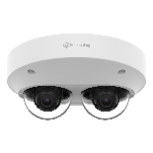
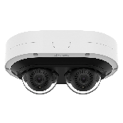
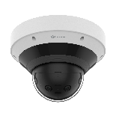
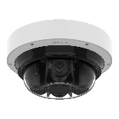
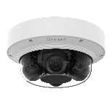
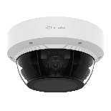
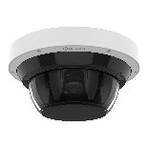
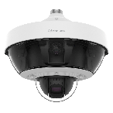
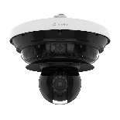
Mount Plate
(Single, Double, 4” octagon, Square)
Mount Plate
(Single, Double, 4” octagon, Square)
Mount Plate
(Single, Double, 4” octagon, Square)
120 x 120
Mount Plate
(Single, Double, 4” octagon, Square)
120 x 120
Mount Plate
(Single, Double, 4” octagon, Square)
120 x 120
PNM-7002VD | PNM-9000VD
PNM-C7082RVD | PNM-C12082RVD | PNM-7082RVD
PNM-12082RVD
PNM-C9022RV | PNM-9031RV | PNM-9022V
PNM-C16083RVQ | PNM-C32083RVQ
PNM-9084QZ1 | PNM-8082VT
Mount Plate
(Single, Double, 4” octagon, Square)
120 x 120
Mount Plate
(Single, Double, 4” octagon, Square)
180 x 180
PF 1-1/2” TAP
ø73mm (2.87") / 3 shafts
PNM-9002VQ
PNM-9084RQZ1 | PNM-9085RQZ1
PNM-9322VQP
PNM-C34404RQPZ

Slide 3
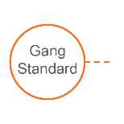
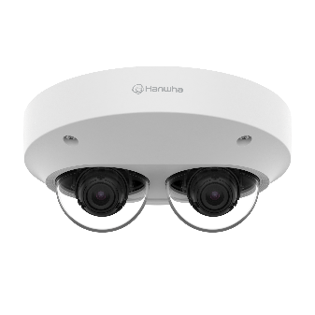
Compatible Camera List
Compatible Installation Solution List
Ceiling 1
Ceiling 2
Wall
Pole
Corner
Parapet
Dimension for Installation
Mount Plate
(Single, Double, 4” octagon, Square)
PNM-7002VD
Ø197.6x84mm(7.78"x3.31")
1250g(2.76 lb)
PNM-9000VD
Ø197.6x84mm(7.78"x3.31")
1250g(2.76 lb)

Slide 4
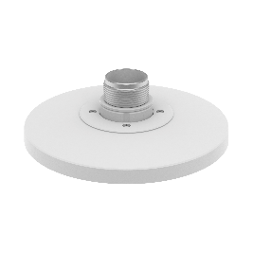
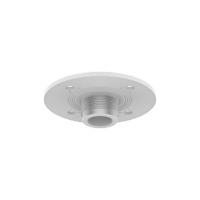
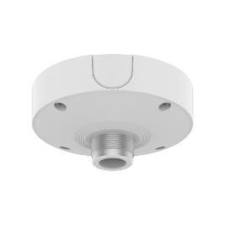
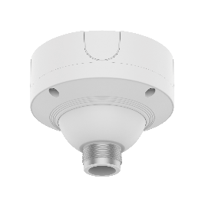
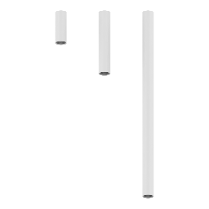
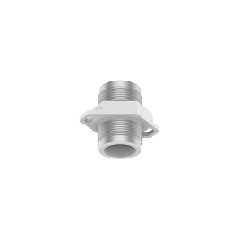
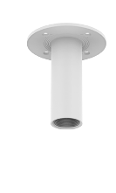
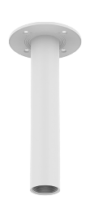
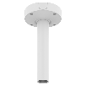
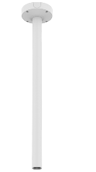
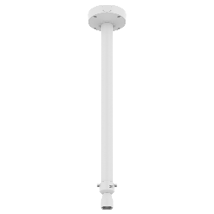
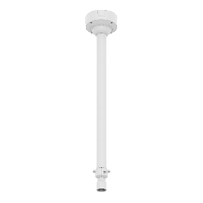
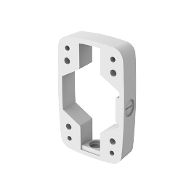
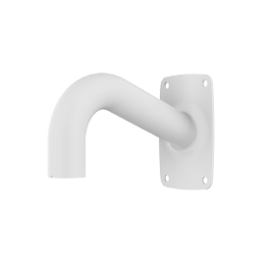
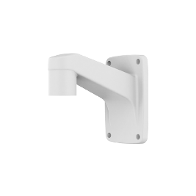
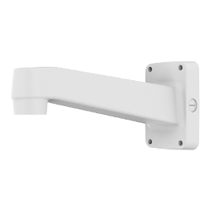
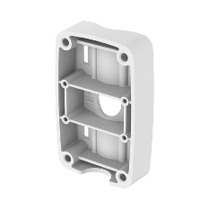
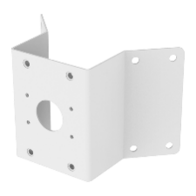
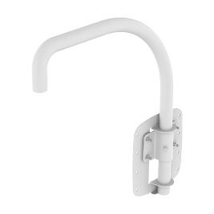
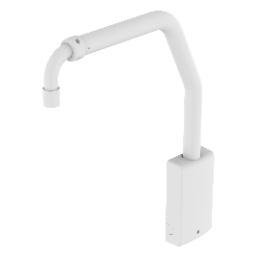
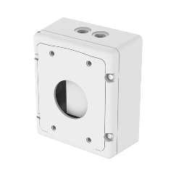
Compatible Camera List
Compatible Installation Solution List
Ceiling 1
Ceiling 2
Wall
Pole
Corner
Parapet
PNM - 7002VD / 9000VD
Ball Head
Hanging Adaptor
SBP-200HMW
Ceiling Mount Base
SBP-140CMB
Ceiling Mount Base
SBP-180CMB
Ceiling Mount Base
SBP-180CMS
Ceiling Mount Pipe
SBP-150CMP/300CMP/900CMP
Ceiling Mount Coupler
SBP-C15P
Ceiling Mount (Assembly)
SBP-150CMI / 300CMI
Ceiling Mount (Assembly)
SBP-300CMW1 / 900CMW
Ceiling Mount (Telescopic)
SBP-300CMTW
Ball Head
Pole Mount
SBP-300PMW2
Corner Mount
SBP-300KMW1
Parapet Mount
SBP-300LMW
Parapet Mount (Telescopic)
SBP-156LMW1
Ceiling Mount (Telescopic)
SBP-300CMTS
Wall Mount Base
SBP-300BW1
Wall Mount
SBP-300WMW
Wall Mount
SBP-300WMW1
Wall Mount
SBP-390WMW2
Cabinet
SBP-300NBW

Slide 5
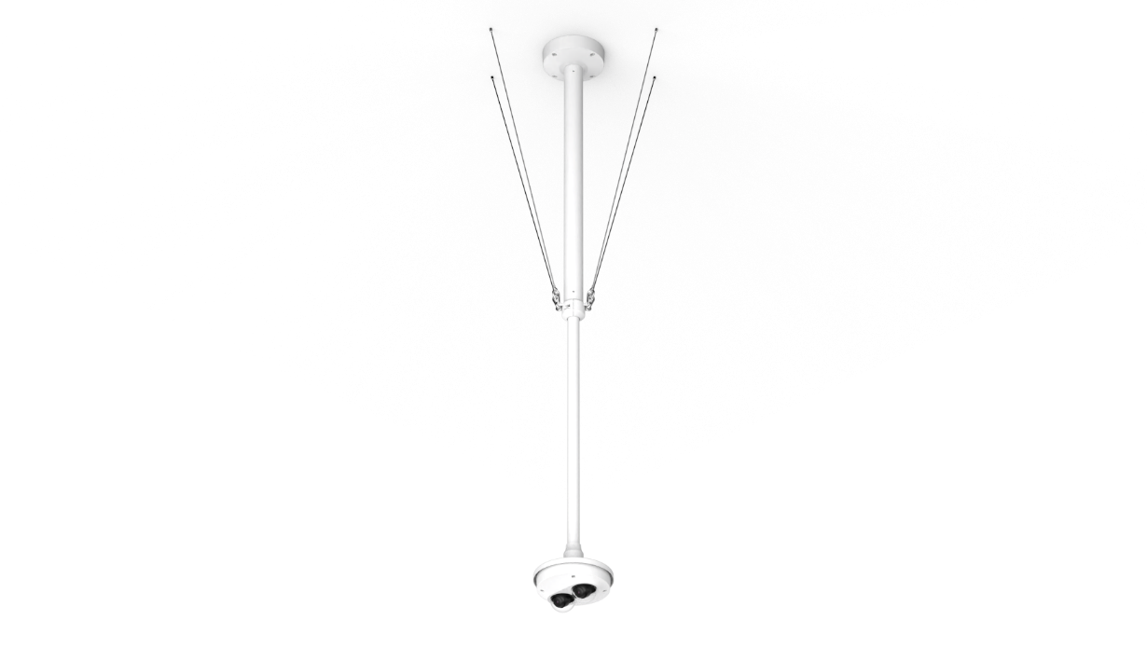
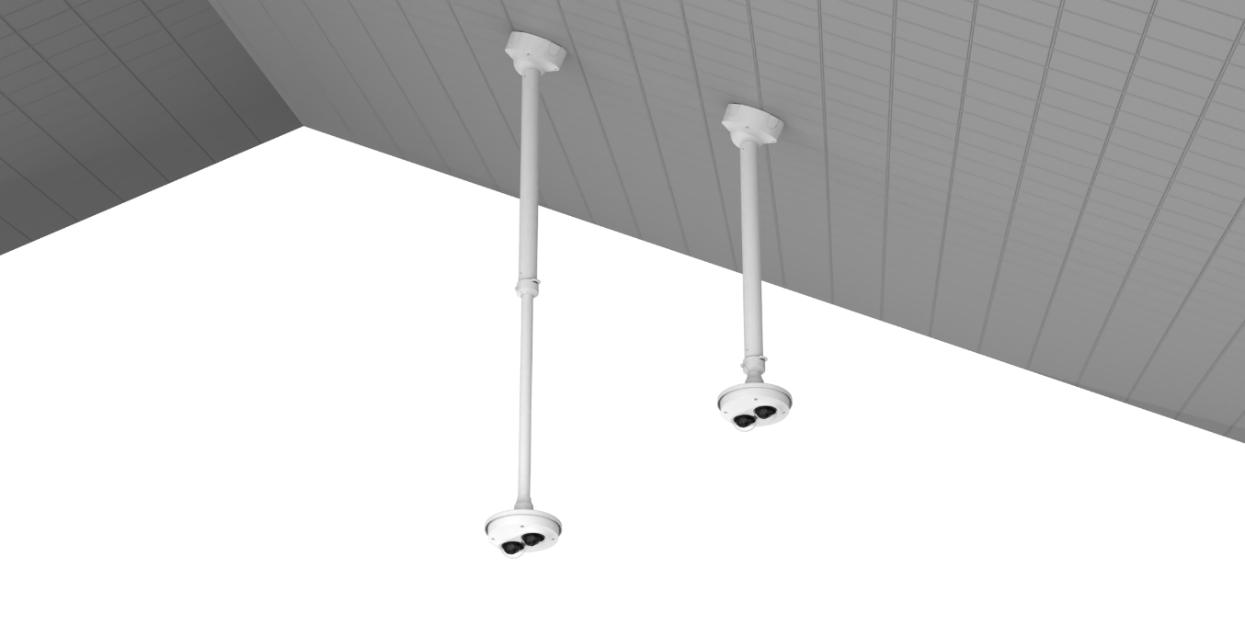
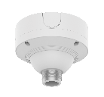
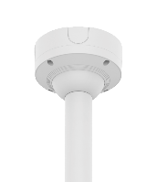
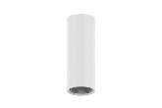
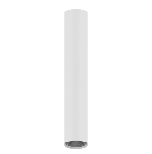
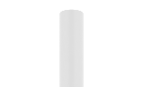
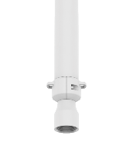
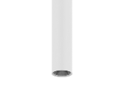
Compatible Camera List
Compatible Installation Solution List
Ceiling 1
Ceiling 2
Wall
Pole
Corner
Parapet
PNM - 7002VD / 9000VD
Ceiling Mount
Hanging Adaptor
Ceiling Mount (Ball Head)
Hanging Adaptor
SBP-180CMS
SBP-180CMS
SBP-180CMS
or
or
or
SBP-150CMP
SBP-300CMTW
SBP-200HMW
SBP-300CMP
SBP-200HMW
SBP-900CMP
SBP-300CMTS

Slide 6
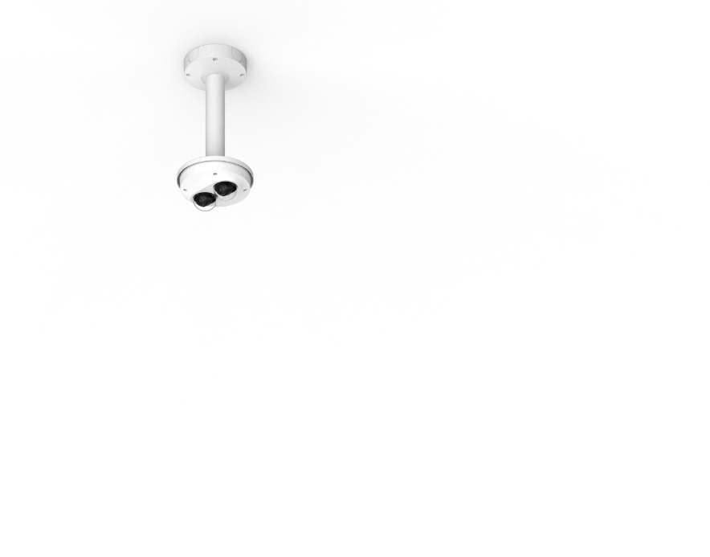
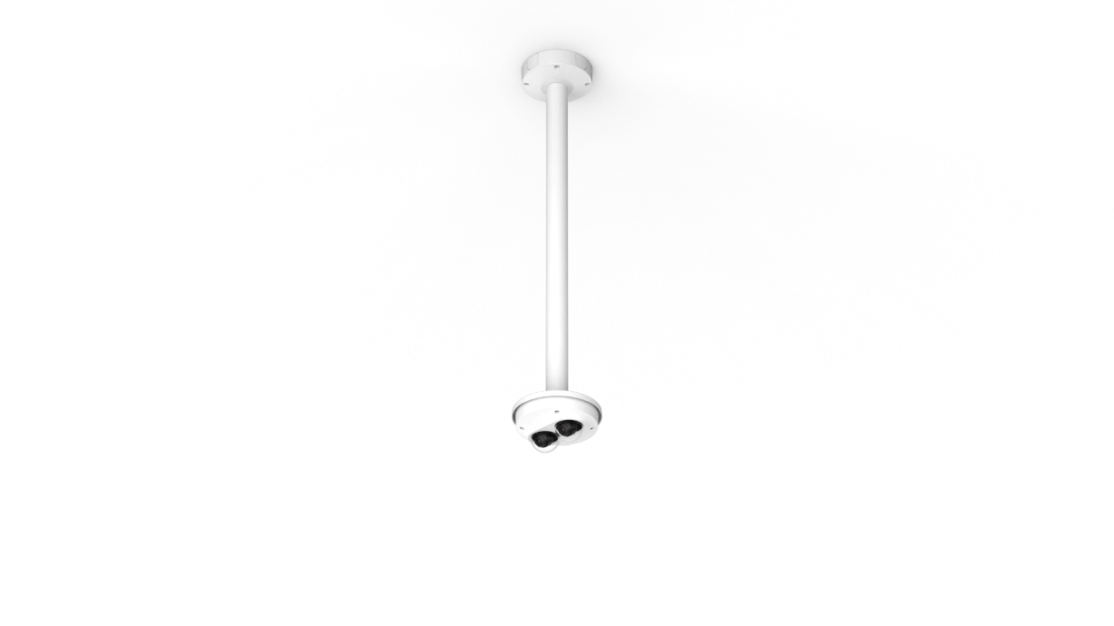
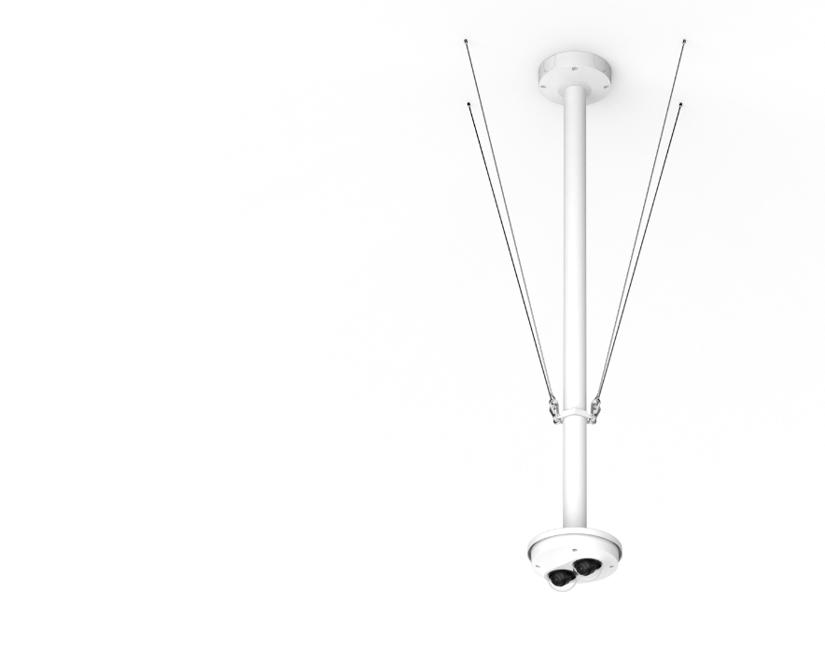
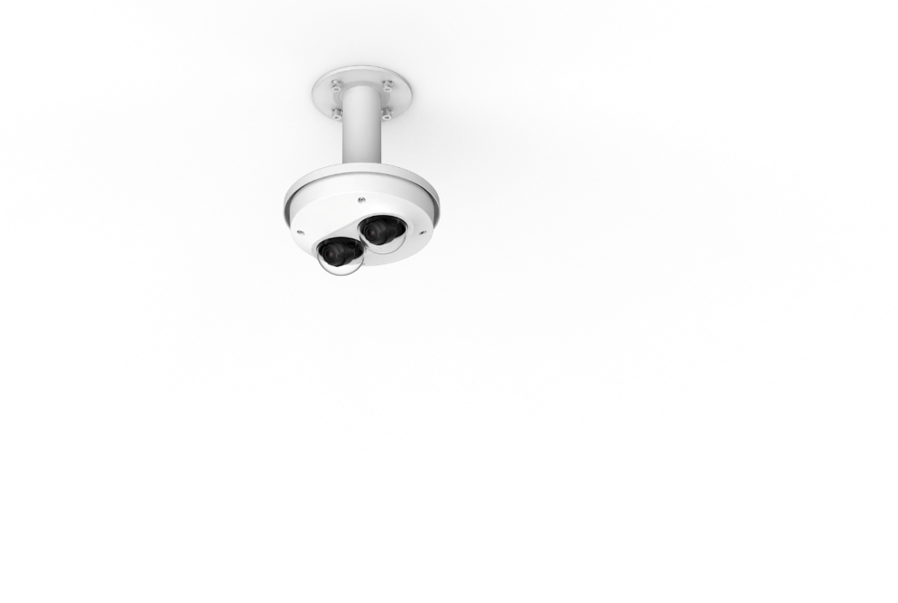
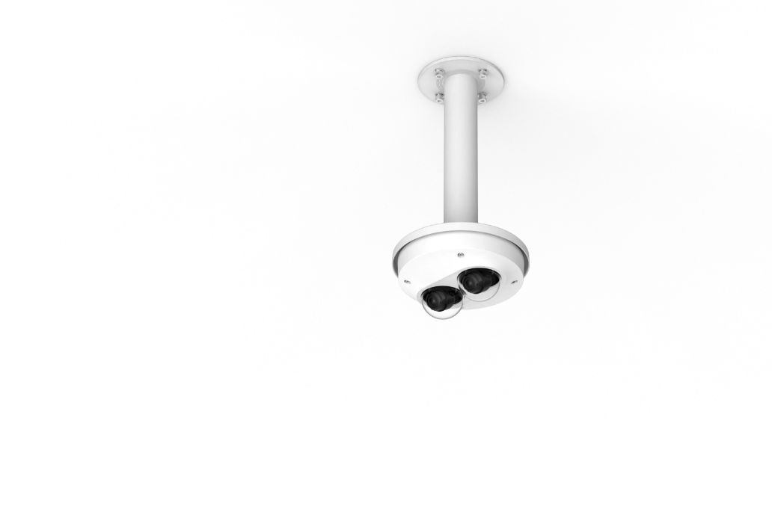
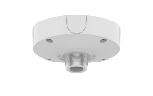
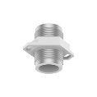


Compatible Camera List
Compatible Installation Solution List
Ceiling 1
Ceiling 2
Wall
Pole
Corner
Parapet
PNM - 7002VD / 9000VD
Ceiling Mount
Hanging Adaptor
Ceiling Mount
Hanging Adaptor
Assembly
SBP-300CMW1
Assembly
SBP-900CMW
Option
Assembly
SBP-150CMI
Assembly
SBP-300CMI
SBP-180CMB
SBP-180CMB
SBP-180CMB
Coupler
SBP-C15P
SBP-140CMB
SBP-140CMB
SBP-140CMB
or
or
+
or
or
SBP-150CMP
SBP-150CMP
SBP-300CMP
SBP-200HMW
SBP-300CMP
SBP-200HMW
SBP-900CMP
Ceiling Mount Pipe
SBP-900CMP

Slide 7
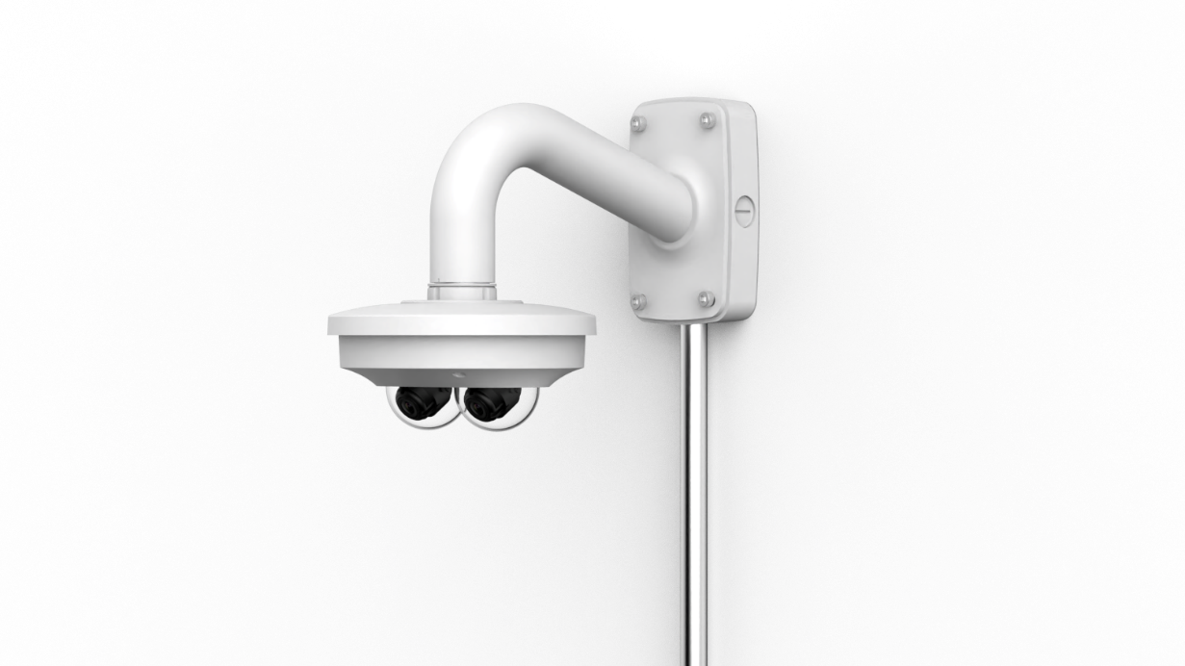
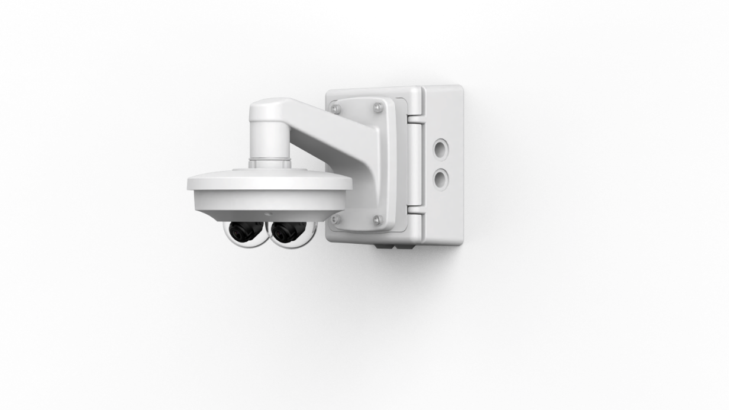






Compatible Camera List
Compatible Installation Solution List
Ceiling 1
Ceiling 2
Wall
Pole
Corner
Parapet
PNM - 7002VD / 9000VD
Wall Mount
Wall Mount
Hanging Adaptor
Option
Option
or
or
or
Cabinet
SBP-300NBW
Wall Mount Base
SBP-300BW1
SBP-300WMW
SBP-300WMW1
Cabinet
SBP-300NBW
SBP-390WMW2
SBP-200HMW

Slide 8



Compatible Camera List
Compatible Installation Solution List
Ceiling 1
Ceiling 2
Wall
Pole
Corner
Parapet
PNM - 7002VD / 9000VD
Pole Mount
Wall Mount
Hanging Adaptor
Option
or
or
SBP-300PMW2
Cabinet
SBP-300NBW
SBP-300WMW
SBP-300WMW1
SBP-390WMW2
SBP-200HMW

Slide 9




Compatible Camera List
Compatible Installation Solution List
Ceiling 1
Ceiling 2
Wall
Pole
Corner
Parapet
PNM - 7002VD / 9000VD
Corner Mount
Wall Mount
Hanging Adaptor
Option
or
or
SBP-300KMW1
Cabinet
SBP-300NBW
SBP-300WMW
SBP-300WMW1
SBP-390WMW2
SBP-200HMW

Slide 10




Compatible Camera List
Compatible Installation Solution List
Ceiling 1
Ceiling 2
Wall
Pole
Corner
Parapet
PNM - 7002VD / 9000VD
Parapet Mount
Hanging Adaptor
Parapet Mount
Hanging Adaptor
SBP-300LMW
SBP-200HMW
SBP-156LMW1
SBP-200HMW

Slide 11

Compatible Camera List
Compatible Installation Solution List
Ceiling 1
Ceiling 2
Wall
Pole
Corner
Parapet
Dimension for Installation
Mount Plate
(Single, Double, 4” octagon, Square)
PNM-C7083RVD
210(W)x135(D)x93.2(H)mm
(8.46"x5.31“x3.67”)
1330g(2.93 lb)
PNM-C12083RVD
210(W)x135(D)x93.2(H)mm
(8.46"x5.31“x3.67”)
1330g(2.93 lb)
PNM-7082RVD
210(W)x135(D)x93.2(H)mm
(8.46"x5.31“x3.67”)
1330g(2.93 lb)
PNM-12082RVD
210(W)x135(D)x93.2(H)mm
(8.46"x5.31“x3.67”)
1330g(2.93 lb)

Slide 12



Compatible Camera List
Compatible Installation Solution List
Ceiling 1
Ceiling 2
Wall
Pole
Corner
Parapet
PNM - C7083RVD / C12083RVD / 7082RVD / 12082RVD
Ball Head
Hanging Adaptor
SBP-215HMW
Ceiling Mount Base
SBP-140CMB
Ceiling Mount Base
SBP-180CMB
Ceiling Mount Base
SBP-180CMS
Ceiling Mount Pipe
SBP-150CMP/300CMP/900CMP
Ceiling Mount Coupler
SBP-C15P
Ceiling Mount (Assembly)
SBP-150CMI / 300CMI
Ceiling Mount (Assembly)
SBP-300CMW1 / 900CMW
Ceiling Mount (Telescopic)
SBP-300CMTW
Ball Head
Pole Mount
SBP-300PMW2
Corner Mount
SBP-300KMW1
Parapet Mount
SBP-300LMW
Parapet Mount (Telescopic)
SBP-156LMW1
Ceiling Mount (Telescopic)
SBP-300CMTS
Wall Mount Base
SBP-300BW1
Wall Mount
SBP-300WMW
Wall Mount
SBP-300WMW1
Wall Mount
SBP-390WMW2
Cabinet
SBP-300NBW
Weather Cap
SBV-215WCW
I/O Box
SPM-4210

Slide 13


Compatible Camera List
Compatible Installation Solution List
Ceiling 1
Ceiling 2
Wall
Pole
Corner
Parapet
PNM - C7083RVD / C12083RVD / 7082RVD / 12082RVD
Ceiling Mount
Hanging Adaptor
Ceiling Mount (Ball Head)
Hanging Adaptor
SBP-180CMS
SBP-180CMS
SBP-180CMS
or
or
or
SBP-150CMP
SBP-300CMTW
SBP-215HMW
SBP-300CMP
SBP-215HMW
SBP-900CMP
SBP-300CMTS

Slide 14





Compatible Camera List
Compatible Installation Solution List
Ceiling 1
Ceiling 2
Wall
Pole
Corner
Parapet
PNM - C7083RVD / C12083RVD / 7082RVD / 12082RVD
Ceiling Mount
Hanging Adaptor
Ceiling Mount
Hanging Adaptor
Assembly
SBP-300CMW1
Assembly
SBP-900CMW
Option
Assembly
SBP-150CMI
Assembly
SBP-300CMI
SBP-180CMB
SBP-180CMB
SBP-180CMB
Coupler
SBP-C15P
SBP-140CMB
SBP-140CMB
SBP-140CMB
or
or
+
or
or
SBP-150CMP
SBP-150CMP
SBP-300CMP
SBP-215HMW
SBP-300CMP
SBP-215HMW
SBP-900CMP
Ceiling Mount Pipe
SBP-900CMP

Slide 15



Compatible Camera List
Compatible Installation Solution List
Ceiling 1
Ceiling 2
Wall
Pole
Corner
Parapet
PNM - C7083RVD / C12083RVD / 7082RVD / 12082RVD
Wall Mount
Wall Mount
Hanging Adaptor
Option
Option
or
or
or
Cabinet
SBP-300NBW
Wall Mount Base
SBP-300BW1
SBP-300WMW
SBP-300WMW1
Cabinet
SBP-300NBW
SBP-390WMW2
SBP-215HMW

Slide 16



Compatible Camera List
Compatible Installation Solution List
Ceiling 1
Ceiling 2
Wall
Pole
Corner
Parapet
PNM - C7083RVD / C12083RVD / 7082RVD / 12082RVD
Pole Mount
Wall Mount
Hanging Adaptor
Option
or
or
SBP-300PMW2
Cabinet
SBP-300NBW
SBP-300WMW
SBP-300WMW1
SBP-390WMW2
SBP-215HMW

Slide 17



Compatible Camera List
Compatible Installation Solution List
Ceiling 1
Ceiling 2
Wall
Pole
Corner
Parapet
PNM - C7083RVD / C12083RVD / 7082RVD / 12082RVD
Corner Mount
Wall Mount
Hanging Adaptor
Option
or
or
SBP-300KMW1
Cabinet
SBP-300NBW
SBP-300WMW
SBP-300WMW1
SBP-390WMW2
SBP-215HMW

Slide 18


Compatible Camera List
Compatible Installation Solution List
Ceiling 1
Ceiling 2
Wall
Pole
Corner
Parapet
PNM - C7083RVD / C12083RVD / 7082RVD / 12082RVD
Parapet Mount
Hanging Adaptor
Parapet Mount
Hanging Adaptor
SBP-300LMW
SBP-215HMW
SBP-156LMW1
SBP-215HMW

Slide 19


Compatible Camera List
Compatible Installation Solution List
Ceiling 1
Ceiling 2
Wall
Pole
Corner
Parapet
Dimension for Installation
Mount Plate
(Single, Double, 4” octagon, Square), 120x120
PNM-C9022RV
Ø253x170mm(9.96"x6.69")
2900g(6.39 lb)
PNM-9031RV
Ø253x170mm(9.96"x6.69")
2900g(6.39 lb)
PNM-9022V
Ø253x165mm(9.96"x6.5")
3200g(7.05 lb)

Slide 20



Compatible Camera List
Compatible Installation Solution List
Ceiling 1
Ceiling 2
Wall
Pole
Corner
Parapet
PNM - C9022RV / 9031RV / 9022V
Ball Head
Hanging Adaptor
SBP-250HMW
Ceiling Mount Base
SBP-140CMB
Ceiling Mount Base
SBP-180CMB
Ceiling Mount Base
SBP-180CMS
Ceiling Mount Pipe
SBP-150CMP/300CMP/900CMP
Ceiling Mount Coupler
SBP-C15P
Ceiling Mount (Assembly)
SBP-150CMI / 300CMI
Ceiling Mount (Assembly)
SBP-300CMW1 / 900CMW
Ceiling Mount (Telescopic)
SBP-300CMTW
Ball Head
Pole Mount
SBP-300PMW2
Corner Mount
SBP-300KMW1
Parapet Mount
SBP-300LMW
Parapet Mount (Telescopic)
SBP-156LMW1
Ceiling Mount (Telescopic)
SBP-300CMTS
Wall Mount Base
SBP-300BW1
Wall Mount
SBP-300WMW
Wall Mount
SBP-300WMW1
Wall Mount
SBP-390WMW2
Cabinet
SBP-300NBW
Weather Cap
SBV-253WCW
PNM-9022V Only
Smoked Dome Cover
SPB-MDC41W

Slide 21


Compatible Camera List
Compatible Installation Solution List
Ceiling 1
Ceiling 2
Wall
Pole
Corner
Parapet
PNM - C9022RV / 9031RV / 9022V
Ceiling Mount
Hanging Adaptor
Ceiling Mount (Ball Head)
Hanging Adaptor
SBP-180CMS
SBP-180CMS
SBP-180CMS
or
or
or
SBP-150CMP
SBP-300CMTW
SBP-250HMW
SBP-300CMP
SBP-250HMW
SBP-900CMP
SBP-300CMTS

Slide 22





Compatible Camera List
Compatible Installation Solution List
Ceiling 1
Ceiling 2
Wall
Pole
Corner
Parapet
PNM - C9022RV / 9031RV / 9022V
Ceiling Mount
Hanging Adaptor
Ceiling Mount
Hanging Adaptor
Assembly
SBP-300CMW1
Assembly
SBP-900CMW
Option
Assembly
SBP-150CMI
Assembly
SBP-300CMI
SBP-180CMB
SBP-180CMB
SBP-180CMB
Coupler
SBP-C15P
SBP-140CMB
SBP-140CMB
SBP-140CMB
or
or
+
or
or
SBP-150CMP
SBP-150CMP
SBP-300CMP
SBP-250HMW
SBP-300CMP
SBP-250HMW
SBP-900CMP
Ceiling Mount Pipe
SBP-900CMP

Slide 23



Compatible Camera List
Compatible Installation Solution List
Ceiling 1
Ceiling 2
Wall
Pole
Corner
Parapet
PNM - C9022RV / 9031RV / 9022V
Wall Mount
Wall Mount
Hanging Adaptor
Option
Option
or
or
or
Cabinet
SBP-300NBW
Wall Mount Base
SBP-300BW1
SBP-300WMW
SBP-300WMW1
Cabinet
SBP-300NBW
SBP-390WMW2
SBP-250HMW

Slide 24



Compatible Camera List
Compatible Installation Solution List
Ceiling 1
Ceiling 2
Wall
Pole
Corner
Parapet
PNM - C9022RV / 9031RV / 9022V
Pole Mount
Wall Mount
Hanging Adaptor
Option
or
or
SBP-300PMW2
Cabinet
SBP-300NBW
SBP-300WMW
SBP-300WMW1
SBP-390WMW2
SBP-250HMW

Slide 25



Compatible Camera List
Compatible Installation Solution List
Ceiling 1
Ceiling 2
Wall
Pole
Corner
Parapet
PNM - C9022RV / 9031RV / 9022V
Corner Mount
Wall Mount
Hanging Adaptor
Option
or
or
SBP-300KMW1
Cabinet
SBP-300NBW
SBP-300WMW
SBP-300WMW1
SBP-390WMW2
SBP-250HMW

Slide 26


Compatible Camera List
Compatible Installation Solution List
Ceiling 1
Ceiling 2
Wall
Pole
Corner
Parapet
PNM - C9022RV / 9031RV / 9022V
Parapet Mount
Hanging Adaptor
Parapet Mount
Hanging Adaptor
SBP-300LMW
SBP-250HMW
SBP-156LMW1
SBP-250HMW

Slide 27

Compatible Camera List
Compatible Installation Solution List
Ceiling 1
Ceiling 2
Wall
Pole
Corner
Parapet
Dimension for Installation
Mount Plate
(Single, Double, 4” octagon, Square), 120x120
PNM-C16083RVQ
Ø250x114.2mm(9.84"x4.50")
2730g(6.02 lb)
PNM-C32083RVQ
Ø250x114.2mm(9.84"x4.50")
2820g(6.22 lb)

Slide 28

Compatible Camera List
Compatible Installation Solution List
Ceiling 1
Ceiling 2
Wall
Pole
Corner
Parapet
PNM - C16083RVQ / C32083RVQ
Ball Head
Hanging Adaptor
SBP-250HMW
Ceiling Mount Base
SBP-140CMB
Ceiling Mount Base
SBP-180CMB
Ceiling Mount Base
SBP-180CMS
Ceiling Mount Pipe
SBP-150CMP/300CMP/900CMP
Ceiling Mount Coupler
SBP-C15P
Ceiling Mount (Assembly)
SBP-150CMI / 300CMI
Ceiling Mount (Assembly)
SBP-300CMW1 / 900CMW
Ceiling Mount (Telescopic)
SBP-300CMTW
Ball Head
Plenum
Pole Mount
SBP-300PMW2
Corner Mount
SBP-300KMW1
Parapet Mount
SBP-300LMW
Ceiling Mount (Telescopic)
SBP-300CMTS
In-ceiling Mount
SHD-2500FPW
Wall Mount Base
SBP-300BW1
Wall Mount
SBP-300WMW
Wall Mount
SBP-300WMW1
Wall Mount
SBP-390WMW2
Parapet Mount (Telescopic)
SBP-156LMW1
Cabinet
SBP-300NBW
I/O Box
SPM-4210

Slide 29



Compatible Camera List
Compatible Installation Solution List
Ceiling 1
Ceiling 2
Wall
Pole
Corner
Parapet
PNM - C16083RVQ / C32083RVQ
In-ceiling Mount
Ceiling Mount
Hanging Adaptor
Ceiling Mount (Ball Head)
Hanging Adaptor
SBP-180CMS
SBP-180CMS
SBP-180CMS
or
or
or
SBP-150CMP
Plenum
SBP-300CMP
SHD-2500FPW
SBP-300CMTW
SBP-250HMW
SBP-900CMP
SBP-300CMTS
SBP-250HMW

Slide 30





Compatible Camera List
Compatible Installation Solution List
Ceiling 1
Ceiling 2
Wall
Pole
Corner
Parapet
PNM - C16083RVQ / C32083RVQ
Ceiling Mount
Hanging Adaptor
Ceiling Mount
Hanging Adaptor
Assembly
SBP-300CMW1
Assembly
SBP-900CMW
Option
Assembly
SBP-150CMI
Assembly
SBP-300CMI
SBP-180CMB
SBP-180CMB
SBP-180CMB
Coupler
SBP-C15P
SBP-140CMB
SBP-140CMB
SBP-140CMB
or
or
+
or
or
SBP-150CMP
SBP-150CMP
SBP-300CMP
SBP-250HMW
SBP-300CMP
SBP-250HMW
SBP-900CMP
Ceiling Mount Pipe
SBP-900CMP

Slide 31



Compatible Camera List
Compatible Installation Solution List
Ceiling 1
Ceiling 2
Wall
Pole
Corner
Parapet
PNM - C16083RVQ / C32083RVQ
Wall Mount
Wall Mount
Hanging Adaptor
Option
Option
or
or
or
Cabinet
SBP-300NBW
Wall Mount Base
SBP-300BW1
SBP-300WMW
SBP-300WMW1
Cabinet
SBP-300NBW
SBP-390WMW2
SBP-250HMW

Slide 32



Compatible Camera List
Compatible Installation Solution List
Ceiling 1
Ceiling 2
Wall
Pole
Corner
Parapet
PNM - C16083RVQ / C32083RVQ
Pole Mount
Wall Mount
Hanging Adaptor
Option
or
or
SBP-300PMW2
Cabinet
SBP-300NBW
SBP-300WMW
SBP-300WMW1
SBP-390WMW2
SBP-250HMW

Slide 33



Compatible Camera List
Compatible Installation Solution List
Ceiling 1
Ceiling 2
Wall
Pole
Corner
Parapet
PNM - C16083RVQ / C32083RVQ
Corner Mount
Wall Mount
Hanging Adaptor
Option
or
or
SBP-300KMW1
Cabinet
SBP-300NBW
SBP-300WMW
SBP-300WMW1
SBP-390WMW2
SBP-250HMW

Slide 34


Compatible Camera List
Compatible Installation Solution List
Ceiling 1
Ceiling 2
Wall
Pole
Corner
Parapet
PNM - C16083RVQ / C32083RVQ
Parapet Mount
Hanging Adaptor
Parapet Mount
Hanging Adaptor
SBP-300LMW
SBP-250HMW
SBP-156LMW1
SBP-250HMW

Slide 35

Compatible Camera List
Compatible Installation Solution List
Ceiling 1
Ceiling 2
Wall
Pole
Corner
Parapet
Dimension for Installation
Mount Plate
(Single, Double, 4” octagon, Square), 120x120
PNM-8082VT
Ø251x116.5mm(9.88"x4.58")
3000g(6.61 lb)
PNM-9084QZ1
Ø251x116.5mm(9.88"x4.58")
3000g(6.61 lb)

Slide 36


Compatible Camera List
Compatible Installation Solution List
Ceiling 1
Ceiling 2
Wall
Pole
Corner
Parapet
PNM - 8082VT / 9084QZ1
Ball Head
Hanging Adaptor
SBP-250HMW
Ceiling Mount Base
SBP-140CMB
Ceiling Mount Base
SBP-180CMB
Ceiling Mount Base
SBP-180CMS
Ceiling Mount Pipe
SBP-150CMP/300CMP/900CMP
Ceiling Mount Coupler
SBP-C15P
Ceiling Mount (Assembly)
SBP-150CMI / 300CMI
Ceiling Mount (Assembly)
SBP-300CMW1 / 900CMW
Ceiling Mount (Telescopic)
SBP-300CMTW
Ball Head
Plenum
Pole Mount
SBP-300PMW2
Corner Mount
SBP-300KMW1
Parapet Mount
SBP-300LMW
Ceiling Mount (Telescopic)
SBP-300CMTS
In-ceiling Mount
SHD-2510FPW
Wall Mount Base
SBP-300BW1
Wall Mount
SBP-300WMW
Wall Mount
SBP-300WMW1
Wall Mount
SBP-390WMW2
Parapet Mount (Telescopic)
SBP-156LMW1
Cabinet
SBP-300NBW
Smoked Dome Cover
SPB-MDC31

Slide 37



Compatible Camera List
Compatible Installation Solution List
Ceiling 1
Ceiling 2
Wall
Pole
Corner
Parapet
PNM - 8082VT / 9084QZ1
In-ceiling Mount
Ceiling Mount
Hanging Adaptor
Ceiling Mount (Ball Head)
Hanging Adaptor
SBP-180CMS
SBP-180CMS
SBP-180CMS
or
or
or
SBP-150CMP
Plenum
SBP-300CMP
SHD-2510FPW
SBP-300CMTW
SBP-250HMW
SBP-900CMP
SBP-300CMTS
SBP-250HMW

Slide 38





Compatible Camera List
Compatible Installation Solution List
Ceiling 1
Ceiling 2
Wall
Pole
Corner
Parapet
PNM - 8082VT / 9084QZ1
Ceiling Mount
Hanging Adaptor
Ceiling Mount
Hanging Adaptor
Assembly
SBP-300CMW1
Assembly
SBP-900CMW
Option
Assembly
SBP-150CMI
Assembly
SBP-300CMI
SBP-180CMB
SBP-180CMB
SBP-180CMB
Coupler
SBP-C15P
SBP-140CMB
SBP-140CMB
SBP-140CMB
or
or
+
or
or
SBP-150CMP
SBP-150CMP
SBP-300CMP
SBP-250HMW
SBP-300CMP
SBP-250HMW
SBP-900CMP
Ceiling Mount Pipe
SBP-900CMP

Slide 39



Compatible Camera List
Compatible Installation Solution List
Ceiling 1
Ceiling 2
Wall
Pole
Corner
Parapet
PNM - 8082VT / 9084QZ1
Wall Mount
Wall Mount
Hanging Adaptor
Option
Option
or
or
or
Cabinet
SBP-300NBW
Wall Mount Base
SBP-300BW1
SBP-300WMW
SBP-300WMW1
Cabinet
SBP-300NBW
SBP-390WMW2
SBP-250HMW

Slide 40



Compatible Camera List
Compatible Installation Solution List
Ceiling 1
Ceiling 2
Wall
Pole
Corner
Parapet
PNM - 8082VT / 9084QZ1
Pole Mount
Wall Mount
Hanging Adaptor
Option
or
or
SBP-300PMW2
Cabinet
SBP-300NBW
SBP-300WMW
SBP-300WMW1
SBP-390WMW2
SBP-250HMW

Slide 41



Compatible Camera List
Compatible Installation Solution List
Ceiling 1
Ceiling 2
Wall
Pole
Corner
Parapet
PNM - 8082VT / 9084QZ1
Corner Mount
Wall Mount
Hanging Adaptor
Option
or
or
SBP-300KMW1
Cabinet
SBP-300NBW
SBP-300WMW
SBP-300WMW1
SBP-390WMW2
SBP-250HMW

Slide 42


Compatible Camera List
Compatible Installation Solution List
Ceiling 1
Ceiling 2
Wall
Pole
Corner
Parapet
PNM - 8082VT / 9084QZ1
Parapet Mount
Hanging Adaptor
Parapet Mount
Hanging Adaptor
SBP-300LMW
SBP-250HMW
SBP-156LMW1
SBP-250HMW

Slide 43

Compatible Camera List
Compatible Installation Solution List
Ceiling 1
Ceiling 2
Wall
Pole
Corner
Parapet
Dimension for Installation
Mount Plate
(Single, Double, 4” octagon, Square), 120x120
PNM-9002VQ
Ø253x130mm(9.96"x5.12")
3000g(6.61 lb)

Slide 44

Compatible Camera List
Compatible Installation Solution List
Ceiling 1
Ceiling 2
Wall
Pole
Corner
Parapet
PNM - 9002VQ
Ball Head
Hanging Adaptor
SBP-250HMW
Ceiling Mount Base
SBP-140CMB
Ceiling Mount Base
SBP-180CMB
Ceiling Mount Base
SBP-180CMS
Ceiling Mount Pipe
SBP-150CMP/300CMP/900CMP
Ceiling Mount Coupler
SBP-C15P
Ceiling Mount (Assembly)
SBP-150CMI / 300CMI
Ceiling Mount (Assembly)
SBP-300CMW1 / 900CMW
Ceiling Mount (Telescopic)
SBP-300CMTW
Ball Head
Plenum
Pole Mount
SBP-300PMW2
Corner Mount
SBP-300KMW1
Parapet Mount
SBP-300LMW
Ceiling Mount (Telescopic)
SBP-300CMTS
In-ceiling Mount
SHD-3000F5
Wall Mount Base
SBP-300BW1
Wall Mount
SBP-300WMW
Wall Mount
SBP-300WMW1
Wall Mount
SBP-390WMW2
Parapet Mount (Telescopic)
SBP-156LMW1
Cabinet
SBP-300NBW

Slide 45



Compatible Camera List
Compatible Installation Solution List
Ceiling 1
Ceiling 2
Wall
Pole
Corner
Parapet
PNM - 9002VQ
In-ceiling Mount
Ceiling Mount
Hanging Adaptor
Ceiling Mount (Ball Head)
Hanging Adaptor
SBP-180CMS
SBP-180CMS
SBP-180CMS
or
or
or
SBP-150CMP
Plenum
SBP-300CMP
SHD-3000F5
SBP-300CMTW
SBP-250HMW
SBP-900CMP
SBP-300CMTS
SBP-250HMW

Slide 46





Compatible Camera List
Compatible Installation Solution List
Ceiling 1
Ceiling 2
Wall
Pole
Corner
Parapet
PNM - 9002VQ
Ceiling Mount
Hanging Adaptor
Ceiling Mount
Hanging Adaptor
Assembly
SBP-300CMW1
Assembly
SBP-900CMW
Option
Assembly
SBP-150CMI
Assembly
SBP-300CMI
SBP-180CMB
SBP-180CMB
SBP-180CMB
Coupler
SBP-C15P
SBP-140CMB
SBP-140CMB
SBP-140CMB
or
or
+
or
or
SBP-150CMP
SBP-150CMP
SBP-300CMP
SBP-250HMW
SBP-300CMP
SBP-250HMW
SBP-900CMP
Ceiling Mount Pipe
SBP-900CMP

Slide 47



Compatible Camera List
Compatible Installation Solution List
Ceiling 1
Ceiling 2
Wall
Pole
Corner
Parapet
PNM - 9002VQ
Wall Mount
Wall Mount
Hanging Adaptor
Option
Option
or
or
or
Cabinet
SBP-300NBW
Wall Mount Base
SBP-300BW1
SBP-300WMW
SBP-300WMW1
Cabinet
SBP-300NBW
SBP-390WMW2
SBP-250HMW

Slide 48



Compatible Camera List
Compatible Installation Solution List
Ceiling 1
Ceiling 2
Wall
Pole
Corner
Parapet
PNM - 9002VQ
Pole Mount
Wall Mount
Hanging Adaptor
Option
or
or
SBP-300PMW2
Cabinet
SBP-300NBW
SBP-300WMW
SBP-300WMW1
SBP-390WMW2
SBP-250HMW

Slide 49



Compatible Camera List
Compatible Installation Solution List
Ceiling 1
Ceiling 2
Wall
Pole
Corner
Parapet
PNM - 9002VQ
Corner Mount
Wall Mount
Hanging Adaptor
Option
or
or
SBP-300KMW1
Cabinet
SBP-300NBW
SBP-300WMW
SBP-300WMW1
SBP-390WMW2
SBP-250HMW

Slide 50


Compatible Camera List
Compatible Installation Solution List
Ceiling 1
Ceiling 2
Wall
Pole
Corner
Parapet
PNM - 9002VQ
Parapet Mount
Hanging Adaptor
Parapet Mount
Hanging Adaptor
SBP-300LMW
SBP-250HMW
SBP-156LMW1
SBP-250HMW

Slide 51

Compatible Camera List
Compatible Installation Solution List
Ceiling 1
Ceiling 2
Wall
Pole
Corner
Parapet
Dimension for Installation
Mount Plate
(Single, Double, 4” octagon, Square), 180x180
PNM-9084RQZ1
Ø315x145.9mm(12.40"x5.74")
5200g(11.5 lb)
PNM-9085RQZ1
Ø315x145.9mm(12.40"x5.74")
5200g(11.5 lb)

Slide 52


Compatible Camera List
Compatible Installation Solution List
Ceiling 1
Ceiling 2
Wall
Pole
Corner
Parapet
PNM - 9084RQZ1 / 9085RQZ1
Ball Head
Hanging Adaptor
SBP-315HMW
Ceiling Mount Base
SBP-140CMB
Ceiling Mount Base
SBP-180CMB
Ceiling Mount Base
SBP-180CMS
Ceiling Mount Pipe
SBP-150CMP/300CMP/900CMP
Ceiling Mount Coupler
SBP-C15P
Ceiling Mount (Assembly)
SBP-150CMI / 300CMI
Ceiling Mount (Assembly)
SBP-300CMW1 / 900CMW
Ceiling Mount (Telescopic)
SBP-300CMTW
Ball Head
Corner Mount
SBP-300KMW1
Parapet Mount
SBP-300LMW
Parapet Mount (Telescopic)
SBP-156LMW1
Cabinet
SBP-300NBW
US Only
Ceiling Mount (Telescopic)
SBP-300CMTS
Wall Mount Base
SBP-300BW1
Wall Mount
SBP-390WMW2
Pole Mount
SBP-300PMW2
In-ceiling Housing
SHD-315F

Slide 53


Compatible Camera List
Compatible Installation Solution List
Ceiling 1
Ceiling 2
Wall
Pole
Corner
Parapet
PNM - 9084RQZ1 / 9085RQZ1
Ceiling Mount
Hanging Adaptor
Ceiling Mount (Ball Head)
Hanging Adaptor
SBP-180CMS
SBP-180CMS
SBP-180CMS
or
or
or
SBP-150CMP
SBP-300CMTW
SBP-315HMW
SBP-300CMP
SBP-315HMW
SBP-900CMP
SBP-300CMTS

Slide 54





Compatible Camera List
Compatible Installation Solution List
Ceiling 1
Ceiling 2
Wall
Pole
Corner
Parapet
PNM - 9084RQZ1 / 9085RQZ1
Ceiling Mount
Hanging Adaptor
Ceiling Mount
Hanging Adaptor
Assembly
SBP-300CMW1
Assembly
SBP-900CMW
Option
Assembly
SBP-150CMI
Assembly
SBP-300CMI
SBP-180CMB
SBP-180CMB
SBP-180CMB
Coupler
SBP-C15P
SBP-140CMB
SBP-140CMB
SBP-140CMB
or
or
+
or
or
SBP-150CMP
SBP-150CMP
SBP-300CMP
SBP-315HMW
SBP-300CMP
SBP-315HMW
SBP-900CMP
Ceiling Mount Pipe
SBP-900CMP

Slide 55


Compatible Camera List
Compatible Installation Solution List
Ceiling 1
Ceiling 2
Wall
Pole
Corner
Parapet
PNM - 9084RQZ1 / 9085RQZ1
Wall Mount
Hanging Adaptor
Pole Mount
Wall Mount
Hanging Adaptor
Option
Option
Cabinet
SBP-300NBW
SBP-390WMW2
SBP-315HMW
SBP-300PMW2
Cabinet
SBP-300NBW
SBP-390WMW2
SBP-315HMW

Slide 56


Compatible Camera List
Compatible Installation Solution List
Ceiling 1
Ceiling 2
Wall
Pole
Corner
Parapet
PNM - 9084RQZ1 / 9085RQZ1
Corner Mount
Wall Mount
Hanging Adaptor
Option
SBP-300KMW1
Cabinet
SBP-300NBW
SBP-390WMW2
SBP-315HMW

Slide 57


Compatible Camera List
Compatible Installation Solution List
Ceiling 1
Ceiling 2
Wall
Pole
Corner
Parapet
PNM - 9084RQZ1 / 9085RQZ1
Parapet Mount
Hanging Adaptor
Parapet Mount
Hanging Adaptor
SBP-300LMW
SBP-315HMW
SBP-156LMW1
SBP-315HMW

Slide 58


Compatible Camera List
Compatible Installation Solution List
Ceiling 1
Ceiling 2
Wall
Pole
Corner
Parapet
Dimension for Installation
PF 1-1/2” TAP
PNM-9322VQP
Ø367.8x335.7mm(14.48"x13.22")
7050g(15.54 lb)

Slide 59

Compatible Camera List
Compatible Installation Solution List
Ceiling 1
Ceiling 2
Wall
Pole
Corner
Parapet
PNM – 9322VQP
Ball Head
Ball Head
Ceiling Mount Base
SBP-140CMB
Ceiling Mount Base
SBP-180CMB
Ceiling Mount Base
SBP-180CMS
Ceiling Mount Pipe
SBP-150CMP/300CMP/900CMP
Ceiling Mount Coupler
SBP-C15P
Ceiling Mount (Assembly)
SBP-150CMI / 300CMI
Ceiling Mount (Assembly)
SBP-300CMW1 / 900CMW
Ceiling Mount (Telescopic)
SBP-300CMTW
Ceiling Mount (Telescopic)
SBP-300CMTS
Wall Mount Base
SBP-300BW1
Wall Mount
SBP-300WMW
Wall Mount
SBP-390WMW2
Pole Mount
SBP-300PMW2
Corner Mount
SBP-300KMW1
Parapet Mount
SBP-300LMW
Parapet Mount (Telescopic)
SBP-156LMW1
Cabinet
SBP-300NBW
Smoked Dome Cover
SPB-MDC51V

Slide 60


Compatible Camera List
Compatible Installation Solution List
Ceiling 1
Ceiling 2
Wall
Pole
Corner
Parapet
PNM – 9322VQP
Ceiling Mount
Ceiling Mount (Ball Head)
SBP-180CMS
SBP-180CMS
SBP-180CMS
or
or
or
SBP-150CMP
SBP-300CMTW
SBP-300CMP
SBP-900CMP
SBP-300CMTS

Slide 61





Compatible Camera List
Compatible Installation Solution List
Ceiling 1
Ceiling 2
Wall
Pole
Corner
Parapet
PNM – 9322VQP
Ceiling Mount
Ceiling Mount
Assembly
SBP-300CMW1
Assembly
SBP-900CMW
Option
Assembly
SBP-150CMI
Assembly
SBP-300CMI
SBP-180CMB
SBP-180CMB
SBP-180CMB
Coupler
SBP-C15P
SBP-140CMB
SBP-140CMB
SBP-140CMB
or
or
+
or
or
SBP-150CMP
SBP-150CMP
SBP-300CMP
SBP-300CMP
SBP-900CMP
Ceiling Mount Pipe
SBP-900CMP

Slide 62


Compatible Camera List
Compatible Installation Solution List
Ceiling 1
Ceiling 2
Wall
Pole
Corner
Parapet
PNM – 9322VQP
Wall Mount
Wall Mount
Option
Option
or
or
Cabinet
SBP-300NBW
Wall Mount Base
SBP-300BW1
SBP-300WMW
Cabinet
SBP-300NBW
SBP-390WMW2

Slide 63


Compatible Camera List
Compatible Installation Solution List
Ceiling 1
Ceiling 2
Wall
Pole
Corner
Parapet
PNM – 9322VQP
Pole Mount
Wall Mount
Option
or
SBP-300PMW2
Cabinet
SBP-300NBW
SBP-300WMW
SBP-390WMW2

Slide 64


Compatible Camera List
Compatible Installation Solution List
Ceiling 1
Ceiling 2
Wall
Pole
Corner
Parapet
PNM – 9322VQP
Corner Mount
Wall Mount
Option
or
SBP-300KMW1
Cabinet
SBP-300NBW
SBP-300WMW
SBP-390WMW2

Slide 65


Compatible Camera List
Compatible Installation Solution List
Ceiling 1
Ceiling 2
Wall
Pole
Corner
Parapet
PNM – 9322VQP
Parapet Mount
Parapet Mount
SBP-300LMW
SBP-156LMW1

Slide 66


Compatible Camera List
Compatible Installation Solution List
Ceiling 1
Ceiling 2
Wall
Pole
Corner
Parapet
Dimension for Installation
ø73.0 (2.87") / 3 shafts
PNM-C34404RQPZ
Ø379.8x301.9mm(14.95"x11.89")
7900g(17.42 lb)

Slide 67




Compatible Camera List
Compatible Installation Solution List
Ceiling 1
Ceiling 2
Wall
Pole
Corner
Parapet
PNM – C34404RQPZ
Ball Head
Hanging Adaptor
SBP-156HMW
Ceiling Mount Base
SBP-140CMB
Ceiling Mount Base
SBP-180CMB
Ceiling Mount Base
SBP-180CMS
Ceiling Mount Pipe
SBP-150CMP/300CMP/900CMP
Ceiling Mount Coupler
SBP-C15P
Ceiling Mount (Assembly)
SBP-150CMI / 300CMI
Ceiling Mount (Assembly)
SBP-300CMW1 / 900CMW
Ceiling Mount (Telescopic)
SBP-300CMTW
Ball Head
Pole Mount
SBP-300PMW2
Corner Mount
SBP-156KMW
Corner Mount
SBP-300KMW1
Parapet Mount
SBP-300LMW
Ceiling Mount (Telescopic)
SBP-300CMTS
Wall & Pole Mount
SBP-156WMW
Wall Mount Base
SBP-300BW1
Wall Mount
SBP-300WMW
Wall Mount
SBP-390WMW2
Parapet Mount (Telescopic)
SBP-156LMW
Cabinet
SBP-300NBW
I/O Box
SPM-4210

Slide 68


Compatible Camera List
Compatible Installation Solution List
Ceiling 1
Ceiling 2
Wall
Pole
Corner
Parapet
PNM – C34404RQPZ
Ceiling Mount
Hanging Adaptor
Ceiling Mount (Ball Head)
Hanging Adaptor
SBP-180CMS
SBP-180CMS
SBP-180CMS
or
or
or
SBP-150CMP
SBP-300CMTW
SBP-156HMW
SBP-300CMP
SBP-156HMW
SBP-900CMP
SBP-300CMTS

Slide 69





Compatible Camera List
Compatible Installation Solution List
Ceiling 1
Ceiling 2
Wall
Pole
Corner
Parapet
PNM – C34404RQPZ
Ceiling Mount
Hanging Adaptor
Ceiling Mount
Hanging Adaptor
Assembly
SBP-300CMW1
Assembly
SBP-900CMW
Option
Assembly
SBP-150CMI
Assembly
SBP-300CMI
SBP-180CMB
SBP-180CMB
SBP-180CMB
Coupler
SBP-C15P
SBP-140CMB
SBP-140CMB
SBP-140CMB
or
or
+
or
or
SBP-150CMP
SBP-150CMP
SBP-300CMP
SBP-156HMW
SBP-300CMP
SBP-156HMW
SBP-900CMP
Ceiling Mount Pipe
SBP-900CMP

Slide 70




Compatible Camera List
Compatible Installation Solution List
Ceiling 1
Ceiling 2
Wall
Pole
Corner
Parapet
PNM – C34404RQPZ
Wall Mount
Wall Mount
Wall Mount
Hanging Adaptor
Option
Option
or
or
SBP-156WMW
Cabinet
SBP-300NBW
Wall Mount Base
SBP-300BW
SBP-300WMW
Cabinet
SBP-300NBW
SBP-390WMW2
SBP-156HMW

Slide 71



Compatible Camera List
Compatible Installation Solution List
Ceiling 1
Ceiling 2
Wall
Pole
Corner
Parapet
PNM – C34404RQPZ
Wall Mount
Pole Mount
Wall Mount
Hanging Adaptor
Option
or
SBP-156WMW
SBP-300PMW2
Cabinet
SBP-300NBW
SBP-300WMW
SBP-390WMW2
SBP-156HMW

Slide 72





Compatible Camera List
Compatible Installation Solution List
Ceiling 1
Ceiling 2
Wall
Pole
Corner
Parapet
PNM – C34404RQPZ
Corner Mount
Wall & Pole Mount
Corner Mount
Wall Mount
Hanging Adaptor
Option
or
SBP-156KMW
SBP-156WMW
SBP-300KMW1
Cabinet
SBP-300NBW
SBP-300WMW
SBP-390WMW2
SBP-156HMW

Slide 73


Compatible Camera List
Compatible Installation Solution List
Ceiling 1
Ceiling 2
Wall
Pole
Corner
Parapet
PNM – C34404RQPZ
Parapet Mount
Hanging Adaptor
Parapet Mount
SBP-300LMW
SBP-156HMW
SBP-156LMW

