Slide 2
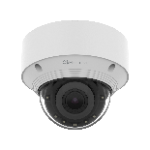
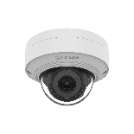
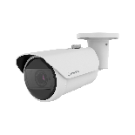
Mount Plate
Ø95.3mm(3.75") / 2 holes
Ø70mm (2.75") / 3 holes
QNV-C8083R | QNV-C9083R
QNV-C8011R | QNV-C9011R | QNV-C8012
QNO-C8083R | QNO-C9083R

Slide 3
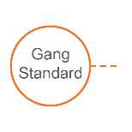
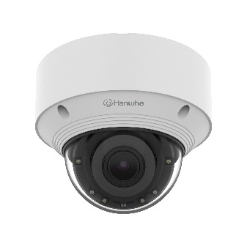
Compatible Camera List
Compatible Installation Solution List
Ceiling 1
Ceiling 2
Wall 1
Wall 2
Pole 1
Pole 2
Corner 1
Corner 2
Parapet
Dimension for Installation
Mount Plate
QNV-C8083R
Ø140x110mm(5.51"x4.34")
875g(1.93 lb)
QNV-C9083R
Ø140x110mm(5.51"x4.34")
875g(1.93 lb)

Slide 4
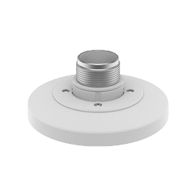
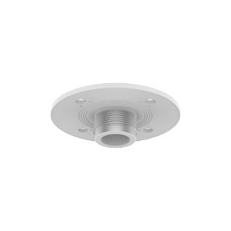
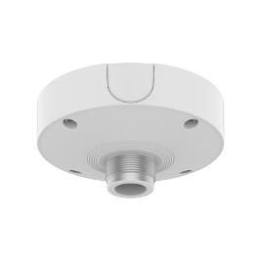
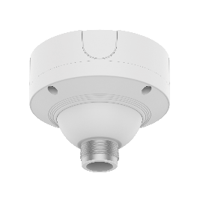
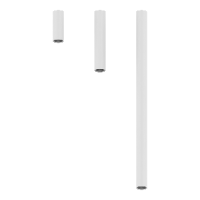
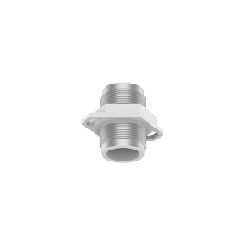
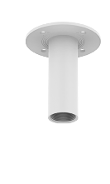
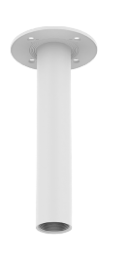
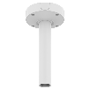
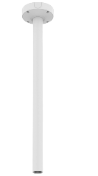
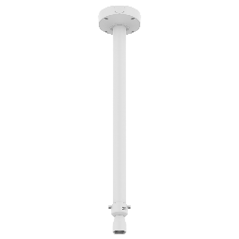
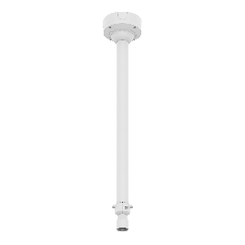
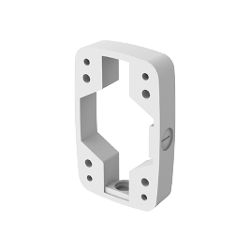
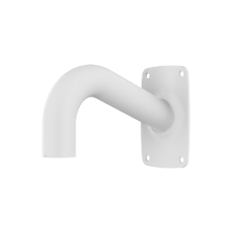
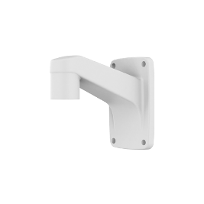
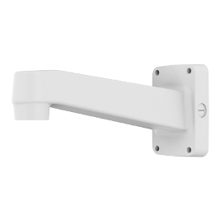
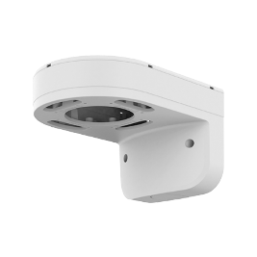
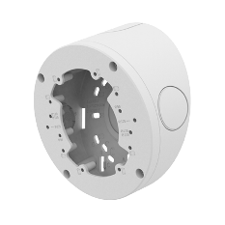
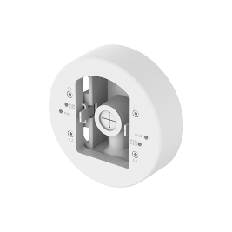
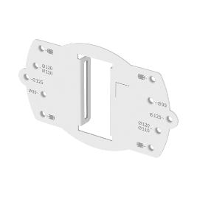
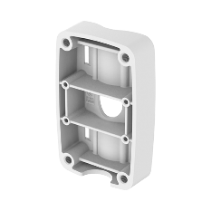
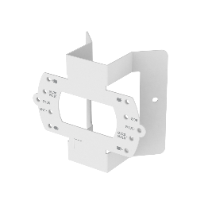
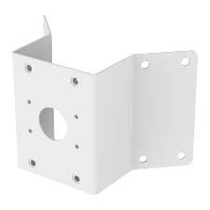
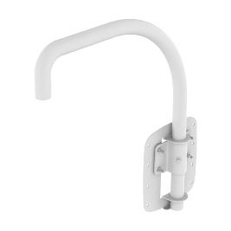
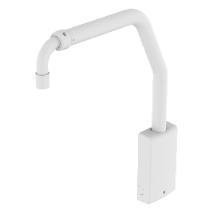
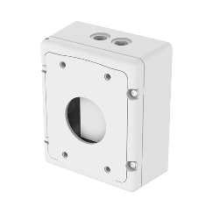
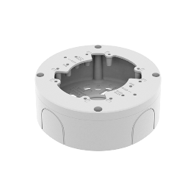
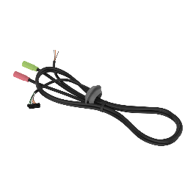
Compatible Camera List
Compatible Installation Solution List
Ceiling 1
Ceiling 2
Wall 1
Wall 2
Pole 1
Pole 2
Corner 1
Corner 2
Parapet
QNV - C8083R / C9083R
Ball Head
Hanging Adaptor
SBP-140HMW
Ceiling Mount Base
SBP-140CMB
Ceiling Mount Base
SBP-180CMB
Ceiling Mount Base
SBP-180CMS
Ceiling Mount Pipe
SBP-150CMP/300CMP/900CMP
Ceiling Mount Coupler
SBP-C15P
Ceiling Mount (Assembly)
SBP-150CMI / 300CMI
Ceiling Mount (Assembly)
SBP-300CMW1 / 900CMW
Ceiling Mount (Telescopic)
SBP-300CMTW
Ball Head
Pole Mount (Light)
SBD-140PMB
Ceiling Mount (Telescopic)
SBP-300CMTS
Wall Mount Base
SBP-300BW
Wall Mount
SBP-300WMW
Wall Mount
SBP-300WMW1
Wall Mount
SBP-390WMW2
Wall & Pole Mount
SBP-140WMW
Tilt Mount
SBV-140TMW
Pole Mount
SBD-140PMW
Pole Mount
SBP-300PMW2
Corner Mount (Light)
SBD-140KMB
Corner Mount
SBP-300KMW1
Parapet Mount
SBP-300LMW
Parapet Mount (Telescopic)
SBP-156LMW1
Cabinet
SBP-300NBW
Back Box
SBV-140BW
Audio & Alarm Cable
SPP-C7400

Slide 5
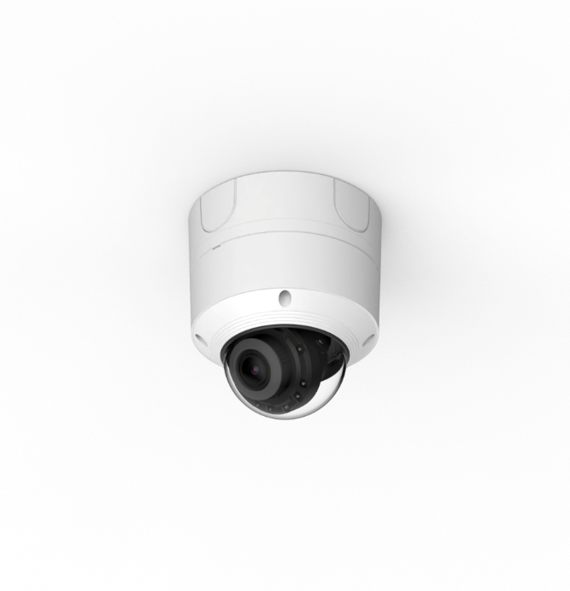
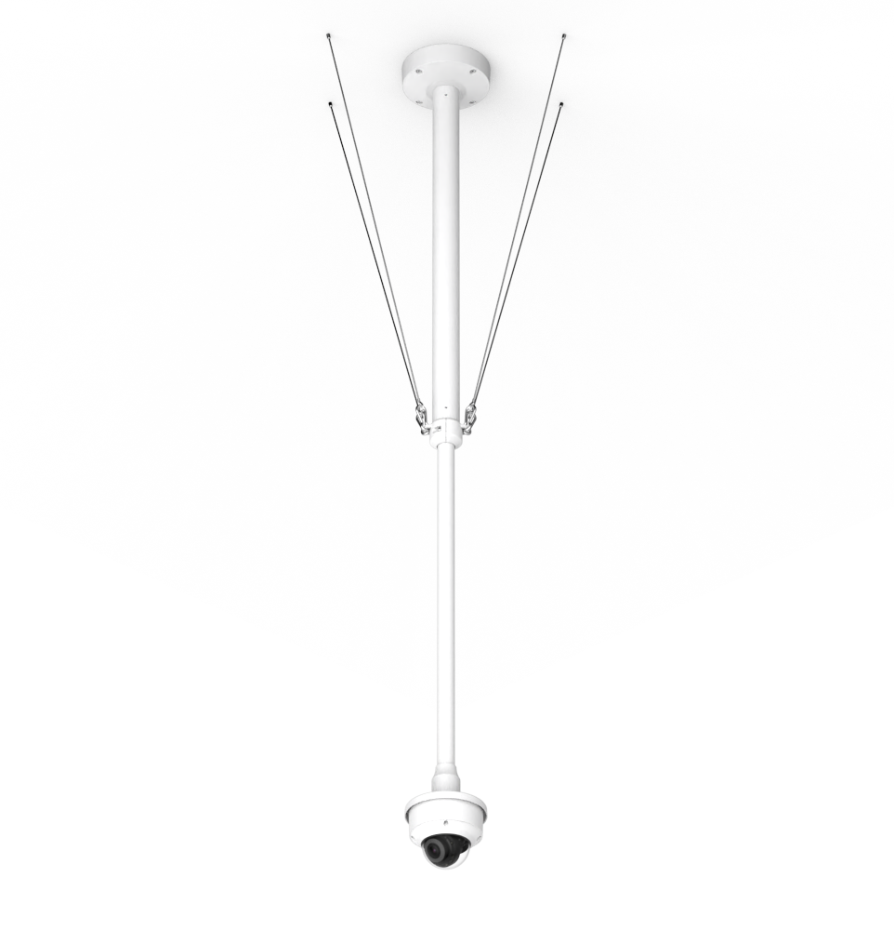
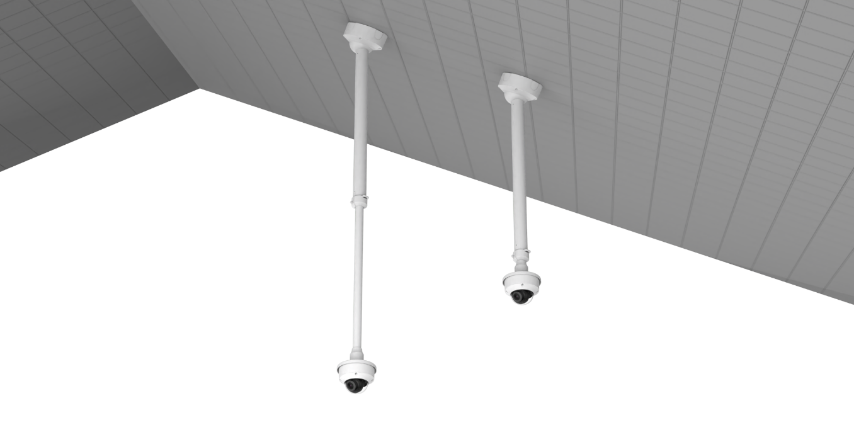
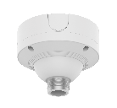
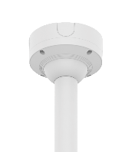
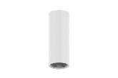
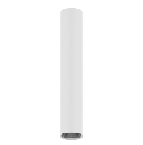
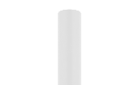
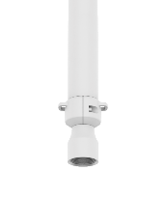
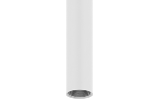
Compatible Camera List
Compatible Installation Solution List
Ceiling 1
Ceiling 2
Wall 1
Wall 2
Pole 1
Pole 2
Corner 1
Corner 2
Parapet
QNV - C8083R / C9083R
Back Box
Ceiling Mount
Hanging Adaptor
Ceiling Mount (Ball Head)
Hanging Adaptor
SBP-180CMS
SBP-180CMS
SBP-180CMS
or
or
or
SBP-150CMP
SBV-140BW
SBP-300CMTW
SBP-140HMW
SBP-300CMP
SBP-140HMW
SBP-900CMP
SBP-300CMTS

Slide 6
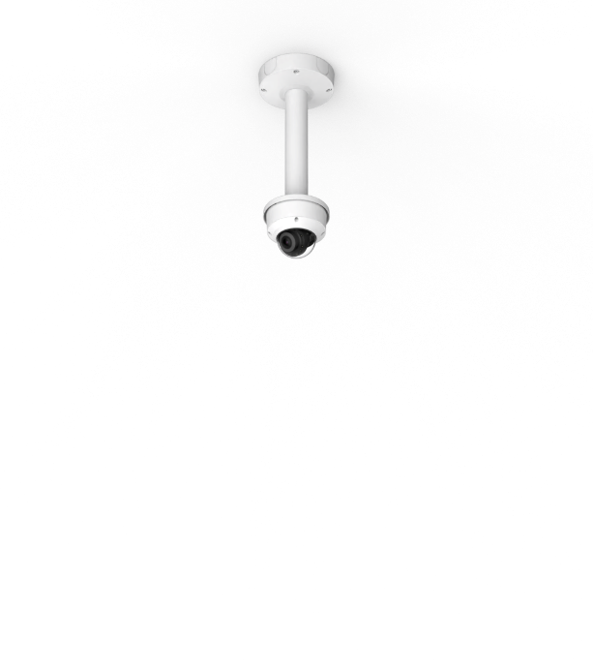
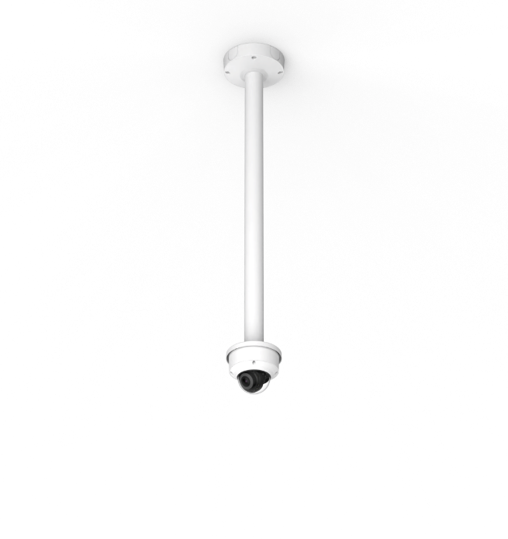
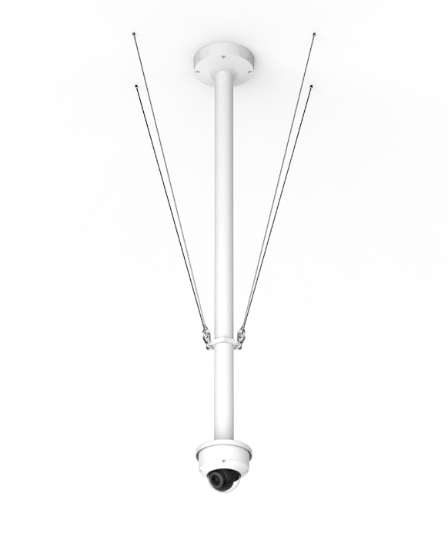
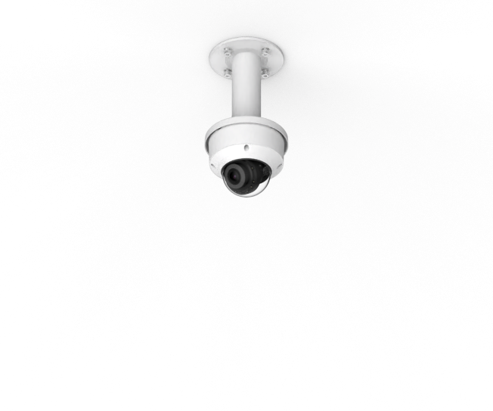
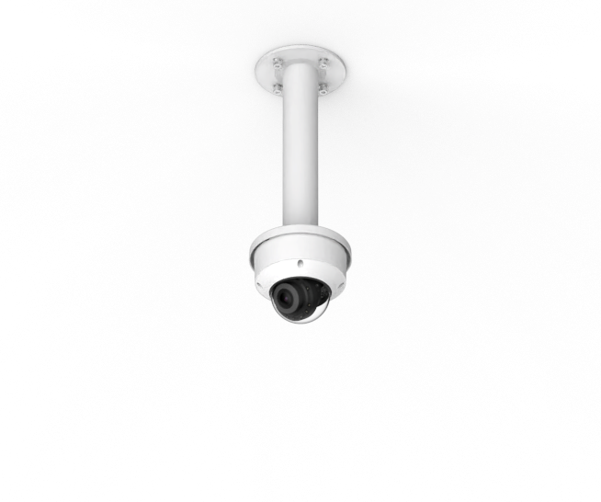
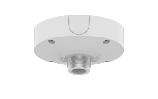
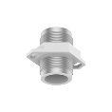


Compatible Camera List
Compatible Installation Solution List
Ceiling 1
Ceiling 2
Wall 1
Wall 2
Pole 1
Pole 2
Corner 1
Corner 2
Parapet
QNV - C8083R / C9083R
Ceiling Mount
Hanging Adaptor
Ceiling Mount
Hanging Adaptor
Assembly
SBP-300CMW1
Assembly
SBP-900CMW
Option
Assembly
SBP-150CMI
Assembly
SBP-300CMI
SBP-180CMB
SBP-180CMB
SBP-180CMB
Coupler
SBP-C15P
SBP-140CMB
SBP-140CMB
SBP-140CMB
or
or
+
or
or
SBP-150CMP
SBP-150CMP
SBP-300CMP
SBP-140HMW
SBP-300CMP
SBP-140HMW
SBP-900CMP
Ceiling Mount Pipe
SBP-900CMP

Slide 7




Compatible Camera List
Compatible Installation Solution List
Ceiling 1
Ceiling 2
Wall 1
Wall 2
Pole 1
Pole 2
Corner 1
Corner 2
Parapet
QNV - C8083R / C9083R
Back Box
Wall & Pole Mount
Tilt Mount
SBV-140BW
SBP-140WMW
SBV-140TMW

Slide 8








Compatible Camera List
Compatible Installation Solution List
Ceiling 1
Ceiling 2
Wall 1
Wall 2
Pole 1
Pole 2
Corner 1
Corner 2
Parapet
QNV - C8083R / C9083R
Wall Mount
Wall Mount
Hanging Adaptor
Option
Option
or
or
or
Cabinet
SBP-300NBW
Wall Mount Base
SBP-300BW
SBP-300WMW
SBP-300WMW1
Cabinet
SBP-300NBW
SBP-390WMW2
SBP-140HMW

Slide 9



Compatible Camera List
Compatible Installation Solution List
Ceiling 1
Ceiling 2
Wall 1
Wall 2
Pole 1
Pole 2
Corner 1
Corner 2
Parapet
QNV - C8083R / C9083R
Pole Mount (Light)
Pole Mount
Wall & Pole Mount
SBD-140PMB
SBD-140PMW
SBP-140WMW

Slide 10



Compatible Camera List
Compatible Installation Solution List
Ceiling 1
Ceiling 2
Wall 1
Wall 2
Pole 1
Pole 2
Corner 1
Corner 2
Parapet
QNV - C8083R / C9083R
Pole Mount
Wall Mount
Hanging Adaptor
Option
or
or
SBP-300PMW2
Cabinet
SBP-300NBW
SBP-300WMW
SBP-300WMW1
SBP-390WMW2
SBP-140HMW

Slide 11


Compatible Camera List
Compatible Installation Solution List
Ceiling 1
Ceiling 2
Wall 1
Wall 2
Pole 1
Pole 2
Corner 1
Corner 2
Parapet
QNV - C8083R / C9083R
Corner Mount (Light)
Corner Mount
Wall & Pole Mount
Corner Mount
or
SBD-140KMB
SBP-300KMW1
SBP-140WMW
SBP-300KMW1

Slide 12




Compatible Camera List
Compatible Installation Solution List
Ceiling 1
Ceiling 2
Wall 1
Wall 2
Pole 1
Pole 2
Corner 1
Corner 2
Parapet
QNV - C8083R / C9083R
Corner Mount
Wall Mount
Hanging Adaptor
Option
or
or
SBP-300KMW1
Cabinet
SBP-300NBW
SBP-300WMW
SBP-300WMW1
SBP-390WMW2
SBP-140HMW

Slide 13




Compatible Camera List
Compatible Installation Solution List
Ceiling 1
Ceiling 2
Wall 1
Wall 2
Pole 1
Pole 2
Corner 1
Corner 2
Parapet
QNV - C8083R / C9083R
Parapet Mount
Hanging Adaptor
Parapet Mount
Hanging Adaptor
SBP-300LMW
SBP-140HMW
SBP-156LMW1
SBP-140HMW

Slide 14



Compatible Camera List
Compatible Installation Solution List
Ceiling 1
Ceiling 2
Wall 1
Wall 2
Pole 1
Pole 2
Corner 1
Corner 2
Parapet
Dimension for Installation
Ø95.3mm(3.75") / 2 holes
QNV-C8011R
Ø110x77mm(4.33"x3.03")
522g(1.15 lb)
QNV-C9011R
Ø110x77mm(4.33"x3.03")
522g(1.15 lb)
QNV-C8012
Ø110x77mm(4.33"x3.03")
522g(1.15 lb)

Slide 15


Compatible Camera List
Compatible Installation Solution List
Ceiling 1
Ceiling 2
Wall 1
Wall 2
Pole 1
Pole 2
Corner 1
Corner 2
Parapet
QNV - C8011R / C9011R / C8012
Ball Head
Hanging Adaptor
SBP-120HMW
Ceiling Mount Base
SBP-140CMB
Ceiling Mount Base
SBP-180CMB
Ceiling Mount Base
SBP-180CMS
Ceiling Mount Pipe
SBP-150CMP/300CMP/900CMP
Ceiling Mount Coupler
SBP-C15P
Ceiling Mount (Assembly)
SBP-150CMI / 300CMI
Ceiling Mount (Assembly)
SBP-300CMW1 / 900CMW
Ceiling Mount (Telescopic)
SBP-300CMTW
Ball Head
Pole Mount (Light)
SBD-140PMB
Ceiling Mount (Telescopic)
SBP-300CMTS
Wall Mount Base
SBP-300BW
Wall Mount
SBP-300WMW
Wall Mount
SBP-300WMW1
Wall Mount
SBP-390WMW2
Wall & Pole Mount
SBP-125WMW1
Tilt Mount
SBV-140TMW
Pole Mount
SBD-140PMW
Pole Mount
SBP-300PMW2
Corner Mount (Light)
SBD-140KMB
Corner Mount
SBP-300KMW1
Parapet Mount
SBP-300LMW
Parapet Mount (Telescopic)
SBP-156LMW1
Cabinet
SBP-300NBW
Back Box
SBV-140BW

Slide 16



Compatible Camera List
Compatible Installation Solution List
Ceiling 1
Ceiling 2
Wall 1
Wall 2
Pole 1
Pole 2
Corner 1
Corner 2
Parapet
QNV - C8011R / C9011R / C8012
Back Box
Ceiling Mount
Hanging Adaptor
Ceiling Mount (Ball Head)
Hanging Adaptor
SBP-180CMS
SBP-180CMS
SBP-180CMS
or
or
or
SBP-150CMP
SBV-140BW
SBP-300CMTW
SBP-120HMW
SBP-300CMP
SBP-120HMW
SBP-900CMP
SBP-300CMTS

Slide 17





Compatible Camera List
Compatible Installation Solution List
Ceiling 1
Ceiling 2
Wall 1
Wall 2
Pole 1
Pole 2
Corner 1
Corner 2
Parapet
QNV - C8011R / C9011R / C8012
Ceiling Mount
Hanging Adaptor
Ceiling Mount
Hanging Adaptor
Assembly
SBP-300CMW1
Assembly
SBP-900CMW
Option
Assembly
SBP-150CMI
Assembly
SBP-300CMI
SBP-180CMB
SBP-180CMB
SBP-180CMB
Coupler
SBP-C15P
SBP-140CMB
SBP-140CMB
SBP-140CMB
or
or
+
or
or
SBP-150CMP
SBP-150CMP
SBP-300CMP
SBP-120HMW
SBP-300CMP
SBP-120HMW
SBP-900CMP
Ceiling Mount Pipe
SBP-900CMP

Slide 18



Compatible Camera List
Compatible Installation Solution List
Ceiling 1
Ceiling 2
Wall 1
Wall 2
Pole 1
Pole 2
Corner 1
Corner 2
Parapet
QNV - C8011R / C9011R / C8012
Back Box
Wall & Pole Mount
Tilt Mount
SBV-140BW
SBP-125WMW1
SBV-140TMW

Slide 19



Compatible Camera List
Compatible Installation Solution List
Ceiling 1
Ceiling 2
Wall 1
Wall 2
Pole 1
Pole 2
Corner 1
Corner 2
Parapet
QNV - C8011R / C9011R / C8012
Wall Mount
Wall Mount
Hanging Adaptor
Option
Option
or
or
or
Cabinet
SBP-300NBW
Wall Mount Base
SBP-300BW
SBP-300WMW
SBP-300WMW1
Cabinet
SBP-300NBW
SBP-390WMW2
SBP-120HMW

Slide 20



Compatible Camera List
Compatible Installation Solution List
Ceiling 1
Ceiling 2
Wall 1
Wall 2
Pole 1
Pole 2
Corner 1
Corner 2
Parapet
QNV - C8011R / C9011R / C8012
Pole Mount (Light)
Pole Mount
Wall & Pole Mount
SBD-140PMB
SBD-140PMW
SBP-125WMW1

Slide 21



Compatible Camera List
Compatible Installation Solution List
Ceiling 1
Ceiling 2
Wall 1
Wall 2
Pole 1
Pole 2
Corner 1
Corner 2
Parapet
QNV - C8011R / C9011R / C8012
Pole Mount
Wall Mount
Hanging Adaptor
Option
or
or
SBP-300PMW2
Cabinet
SBP-300NBW
SBP-300WMW
SBP-300WMW1
SBP-390WMW2
SBP-120HMW

Slide 22


Compatible Camera List
Compatible Installation Solution List
Ceiling 1
Ceiling 2
Wall 1
Wall 2
Pole 1
Pole 2
Corner 1
Corner 2
Parapet
QNV - C8011R / C9011R / C8012
Corner Mount (Light)
Corner Mount
Wall & Pole Mount
Corner Mount
or
SBD-140KMB
SBP-300KMW1
SBP-125WMW1
SBP-300KMW1

Slide 23



Compatible Camera List
Compatible Installation Solution List
Ceiling 1
Ceiling 2
Wall 1
Wall 2
Pole 1
Pole 2
Corner 1
Corner 2
Parapet
QNV - C8011R / C9011R / C8012
Corner Mount
Wall Mount
Hanging Adaptor
Option
or
or
SBP-300KMW1
Cabinet
SBP-300NBW
SBP-300WMW
SBP-300WMW1
SBP-390WMW2
SBP-120HMW

Slide 24


Compatible Camera List
Compatible Installation Solution List
Ceiling 1
Ceiling 2
Wall 1
Wall 2
Pole 1
Pole 2
Corner 1
Corner 2
Parapet
QNV - C8011R / C9011R / C8012
Parapet Mount
Hanging Adaptor
Parapet Mount
Hanging Adaptor
SBP-300LMW
SBP-120HMW
SBP-156LMW1
SBP-120HMW

Slide 25


Compatible Camera List
Compatible Installation Solution List
Ceiling 1
Ceiling 2
Ceiling 3
Ceiling 4
Wall 1
Wall 2
Pole 1
Pole 2
Corner 1
Corner 2
Parapet
Dimension for Installation
Ø70mm(2.75") / 3 holes
QNO-C8083R
Ø93.4x245.8mm(3.68"x9.68")
930g(2.05 lb)
QNO-C9083R
Ø93.4x245.8mm(3.68"x9.68")
930g(2.05 lb)

Slide 26


Compatible Camera List
Compatible Installation Solution List
Ceiling 1
Ceiling 2
Ceiling 3
Ceiling 4
Wall 1
Wall 2
Pole 1
Pole 2
Corner 1
Corner 2
Parapet
QNO - C8083R / C9083R
※ Essential Model for additional compatibility ※
Back Box
SBO-140BW
Gang Plate
SBO-090GP
Ball Head
Hanging Adaptor
SBP-140HMW
Ceiling Mount Base
SBP-140CMB
Ceiling Mount Base
SBP-180CMB
Ceiling Mount Base
SBP-180CMS
Ceiling Mount Pipe
SBP-150CMP/300CMP/900CMP
Ceiling Mount Coupler
SBP-C15P
Ceiling Mount (Assembly)
SBP-150CMI / 300CMI
Ceiling Mount (Assembly)
SBP-300CMW1 / 900CMW
Ceiling Mount (Telescopic)
SBP-300CMTW
Ball Head
Ceiling Mount (Telescopic)
SBP-300CMTS
Wall Mount Base
SBP-300BW
Wall Mount
SBP-300WMW
Wall Mount
SBP-300WMW1
Wall Mount
SBP-390WMW2
Wall & Pole Mount
SBP-140WMW
Tilt Mount
SBV-140TMW
Pole Mount
SBD-140PMW
Pole Mount (Light)
SBD-140PMB
Pole Mount
SBP-300PMW2
Corner Mount (Light)
SBD-140KMB
Corner Mount
SBP-300KMW1
Parapet Mount
SBP-300LMW
Parapet Mount (Telescopic)
SBP-156LMW1
Cabinet
SBP-300NBW

Slide 27




Compatible Camera List
Compatible Installation Solution List
Ceiling 1
Ceiling 2
Ceiling 3
Ceiling 4
Wall 1
Wall 2
Pole 1
Pole 2
Corner 1
Corner 2
Parapet
QNO - C8083R / C9083R
Gang Box
Back Box
Gang Plate
Ceiling Mount
Hanging Adaptor
Back Box
Gang Plate
or
or
SBO-140BW
SBO-090GP
SBP-300CMTW
SBP-140WMW
SBO-140BW
SBO-090GP

Slide 28

Compatible Camera List
Compatible Installation Solution List
Ceiling 1
Ceiling 2
Ceiling 3
Ceiling 4
Wall 1
Wall 2
Pole 1
Pole 2
Corner 1
Corner 2
Parapet
QNO - C8083R / C9083R
Ceiling Mount (Ball Head)
Hanging Adaptor
Back Box
Gang Plate
SBP-180CMS
SBP-180CMS
SBP-180CMS
or
or
or
or
SBP-150CMP
SBP-300CMP
SBP-140HMW
SBO-140BW
SBO-090GP
SBP-900CMP
SBP-300CMTS

Slide 29




Compatible Camera List
Compatible Installation Solution List
Ceiling 1
Ceiling 2
Ceiling 3
Ceiling 4
Wall 1
Wall 2
Pole 1
Pole 2
Corner 1
Corner 2
Parapet
QNO - C8083R / C9083R
Ceiling Mount
Hanging Adaptor
Back Box
Gang Plate
Assembly
SBP-150CMI
Assembly
SBP-300CMI
SBP-140CMB
SBP-140CMB
SBP-140CMB
or
or
or
SBP-150CMP
SBP-300CMP
SBP-140HMW
SBO-140BW
SBO-090GP
SBP-900CMP

Slide 30






Compatible Camera List
Compatible Installation Solution List
Ceiling 1
Ceiling 2
Ceiling 3
Ceiling 4
Wall 1
Wall 2
Pole 1
Pole 2
Corner 1
Corner 2
Parapet
QNO - C8083R / C9083R
Ceiling Mount
Hanging Adaptor
Back Box
Gang Plate
Assembly
SBP-300CMW1
Assembly
SBP-900CMW
Option
SBP-180CMB
SBP-180CMB
SBP-180CMB
Coupler
SBP-C15P
or
or
+
or
SBP-150CMP
SBP-300CMP
SBP-140HMW
SBO-140BW
SBO-090GP
SBP-900CMP
Ceiling Mount Pipe

Slide 31




Compatible Camera List
Compatible Installation Solution List
Ceiling 1
Ceiling 2
Ceiling 3
Ceiling 4
Wall 1
Wall 2
Pole 1
Pole 2
Corner 1
Corner 2
Parapet
QNO - C8083R / C9083R
Gang Box
Back Box
Gang Plate
Wall & Pole Mount
Back Box
Gang Plate
Tilt Mount
Back Box
Gang Plate
or
or
or
SBO-140BW
SBO-090GP
SBP-140WMW
SBO-140BW
SBO-090GP
SBV-140TMW
SBO-140BW
SBO-090GP

Slide 32



Compatible Camera List
Compatible Installation Solution List
Ceiling 1
Ceiling 2
Ceiling 3
Ceiling 4
Wall 1
Wall 2
Pole 1
Pole 2
Corner 1
Corner 2
Parapet
QNO - C8083R / C9083R
Wall Mount
Wall Mount
Hanging Adaptor
Back Box
Gang Plate
Option
Option
or
or
or
or
Cabinet
SBP-300NBW
Wall Mount Base
SBP-300BW
SBP-300WMW
SBP-300WMW1
Cabinet
SBP-300NBW
SBP-390WMW2
SBP-140HMW
SBO-140BW
SBO-090GP

Slide 33



Compatible Camera List
Compatible Installation Solution List
Ceiling 1
Ceiling 2
Ceiling 3
Ceiling 4
Wall 1
Wall 2
Pole 1
Pole 2
Corner 1
Corner 2
Parapet
QNO - C8083R / C9083R
Pole Mount (Light)
Back Box
Gang Plate
Pole Mount
Back Box
Gang Plate
Wall & Pole Mount
Back Box
Gang Plate
or
or
or
SBD-140PMB
SBO-140BW
SBO-090GP
SBD-140PMW
SBO-140BW
SBO-090GP
SBP-140WMW
SBO-140BW
SBO-090GP

Slide 34



Compatible Camera List
Compatible Installation Solution List
Ceiling 1
Ceiling 2
Ceiling 3
Ceiling 4
Wall 1
Wall 2
Pole 1
Pole 2
Corner 1
Corner 2
Parapet
QNO - C8083R / C9083R
Pole Mount
Wall Mount
Hanging Adaptor
Back Box
Gang Plate
Option
or
or
or
SBP-300PMW2
Cabinet
SBP-300NBW
SBP-300WMW
SBP-300WMW1
SBP-390WMW2
SBP-140HMW
SBO-140BW
SBO-090GP

Slide 35


Compatible Camera List
Compatible Installation Solution List
Ceiling 1
Ceiling 2
Ceiling 3
Ceiling 4
Wall 1
Wall 2
Pole 1
Pole 2
Corner 1
Corner 2
Parapet
QNO - C8083R / C9083R
Corner Mount (Light)
Corner Mount
Back Box
Gang Plate
Corner Mount
Wall & Pole Mount
Back Box
Gang Plate
or
or
or
or
SBD-140KMB
SBP-300KMW1
SBO-140BW
SBO-090GP
SBP-300KMW1
SBP-140WMW
SBO-140BW
SBO-090GP

Slide 36



Compatible Camera List
Compatible Installation Solution List
Ceiling 1
Ceiling 2
Ceiling 3
Ceiling 4
Wall 1
Wall 2
Pole 1
Pole 2
Corner 1
Corner 2
Parapet
QNO - C8083R / C9083R
Corner Mount
Wall Mount
Hanging Adaptor
Back Box
Gang Plate
Option
or
or
or
SBP-300KMW1
Cabinet
SBP-300NBW
SBP-300WMW
SBP-300WMW1
SBP-390WMW2
SBP-140HMW
SBO-140BW
SBO-090GP

Slide 37


Compatible Camera List
Compatible Installation Solution List
Ceiling 1
Ceiling 2
Ceiling 3
Ceiling 4
Wall 1
Wall 2
Pole 1
Pole 2
Corner 1
Corner 2
Parapet
QNO - C8083R / C9083R
Parapet Mount
Hanging Adaptor
Back Box
Gang Plate
Parapet Mount
Hanging Adaptor
Back Box
Gang Plate
or
or
SBP-300LMW
SBP-140HMW
SBO-140BW
SBO-090GP
SBP-156LMW1
SBP-140WMW
SBO-140BW
SBO-090GP

